Slide 1
Презентация The Unsung Museum of London подготовлена студентом математического факультета Александром Барановским для выступления на заседании страноведческого кружка «Культура и традиции Великобритании и США».

Slide 2
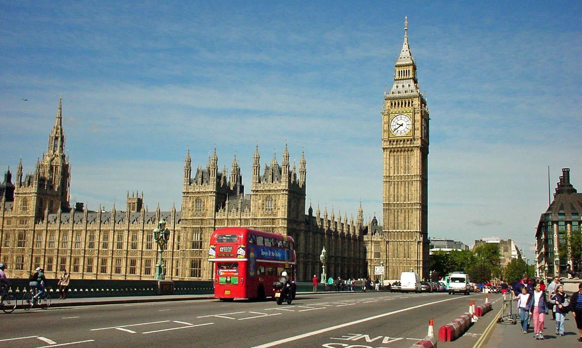
The unsung museums of London
        Baranovskyi
Supervision: Chernyakova E.A.

Slide 3
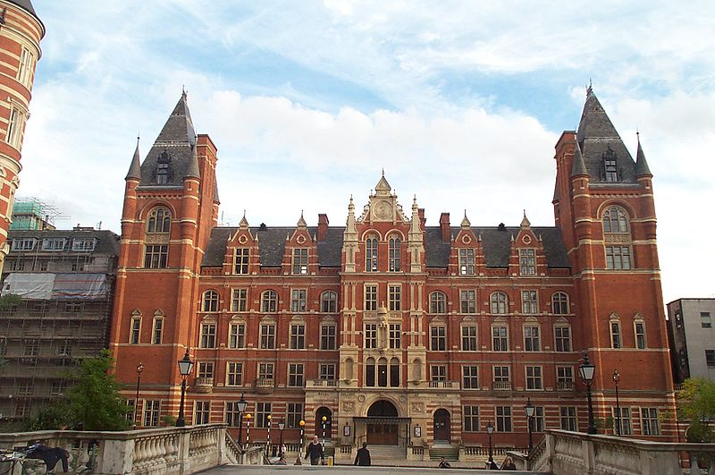
Royal College of Music – Museum of Instruments

Slide 4
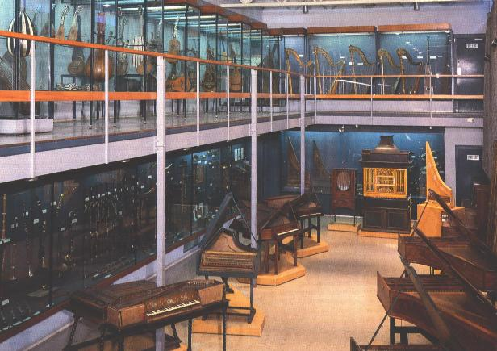
The college's museum of instruments, forming part of the centre for performance history, houses a collection of more than 800 instruments and accessories from circa 1480 to the present. Included in the collection is a clavicytherium that is the world's oldest surviving keyboard instrument.

Slide 5
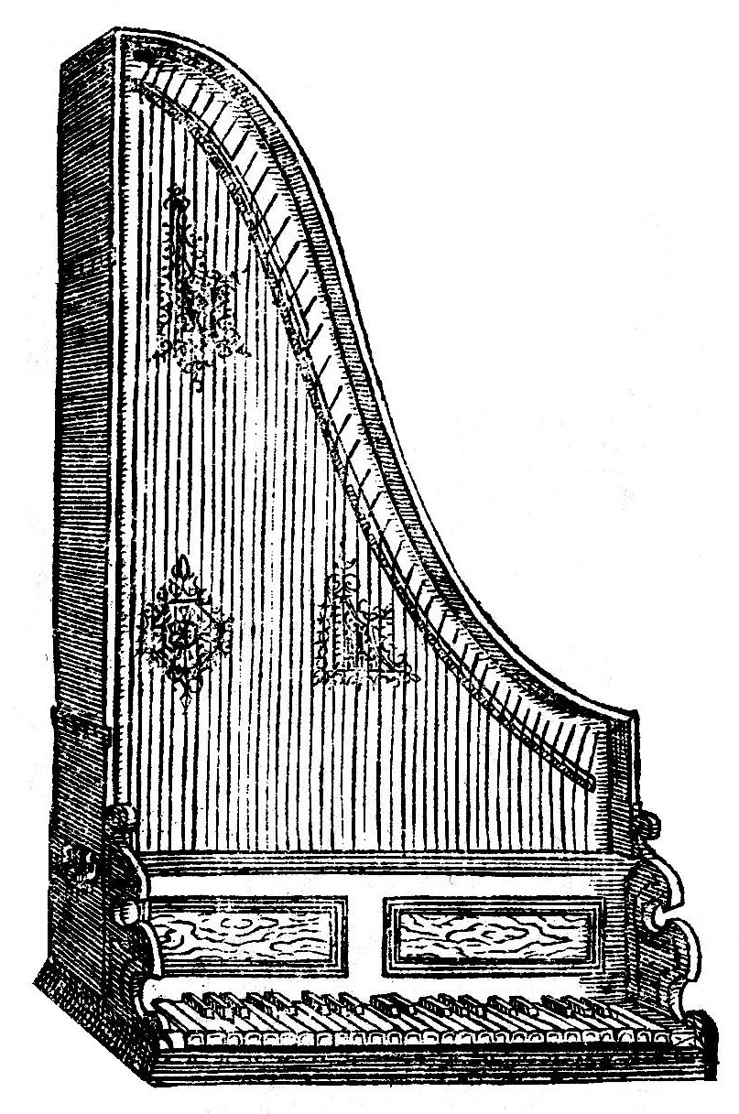

Slide 6
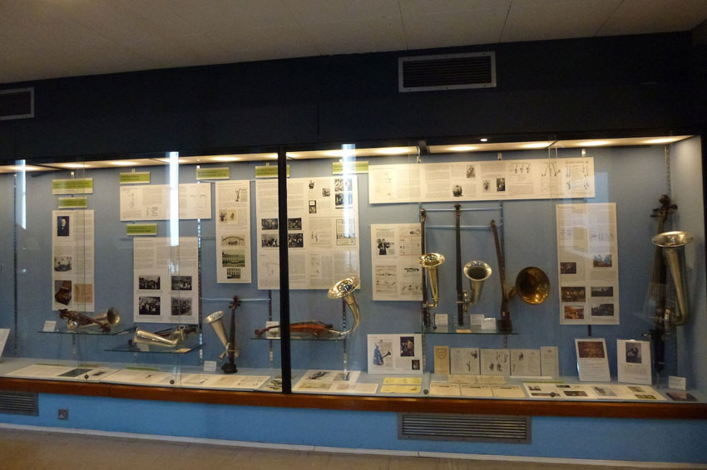
Owing partly to the vision of its founders, particularly Grove, the RCM holds significant research collections of material dating from the fifteenth century onwards. These include autographs such as Haydn's String Quartet Op. 64/1, Mozart's Piano Concerto K491 and Elgar's Cello Concerto.

Slide 7
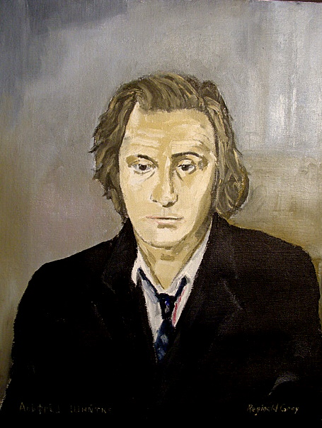
A recent addition to the collection is a portrait of the Russian composer Alfred Schnittke by Reginald Gray.

Slide 8
10,000 prints and photographs constitute the most substantial archive of images of musicians in the UK. The RCM's 600,000 concert programmes document concert life from 1730 to the present day.

Slide 9
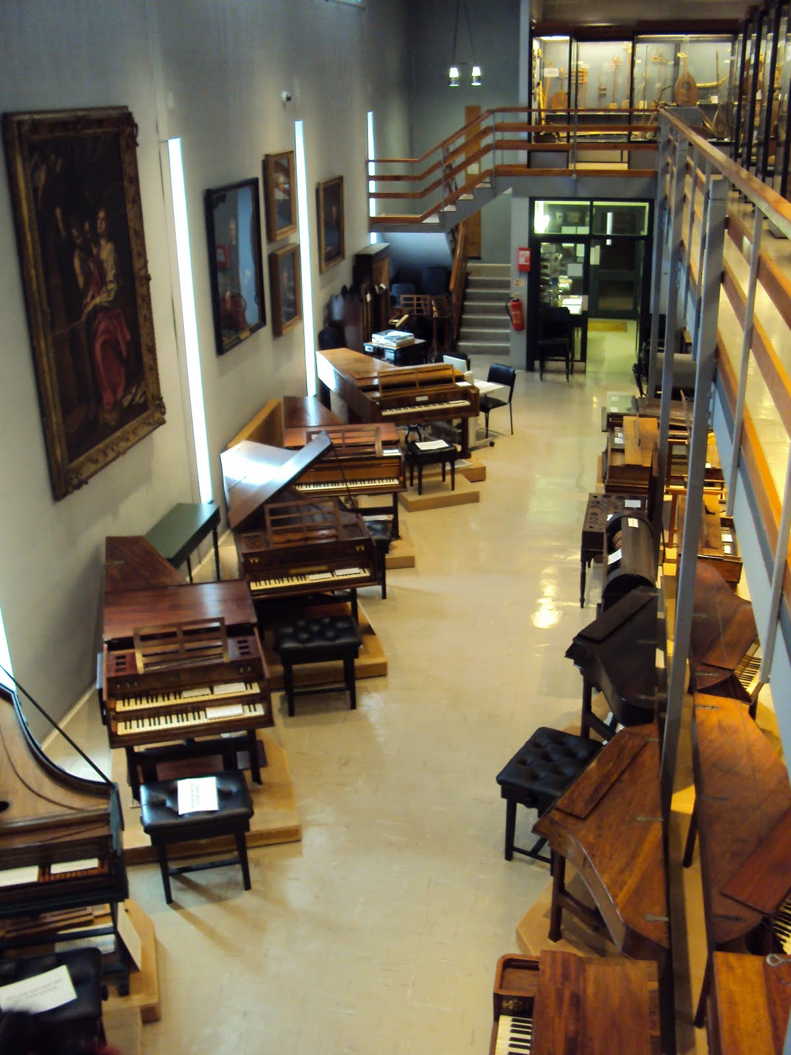

Slide 10
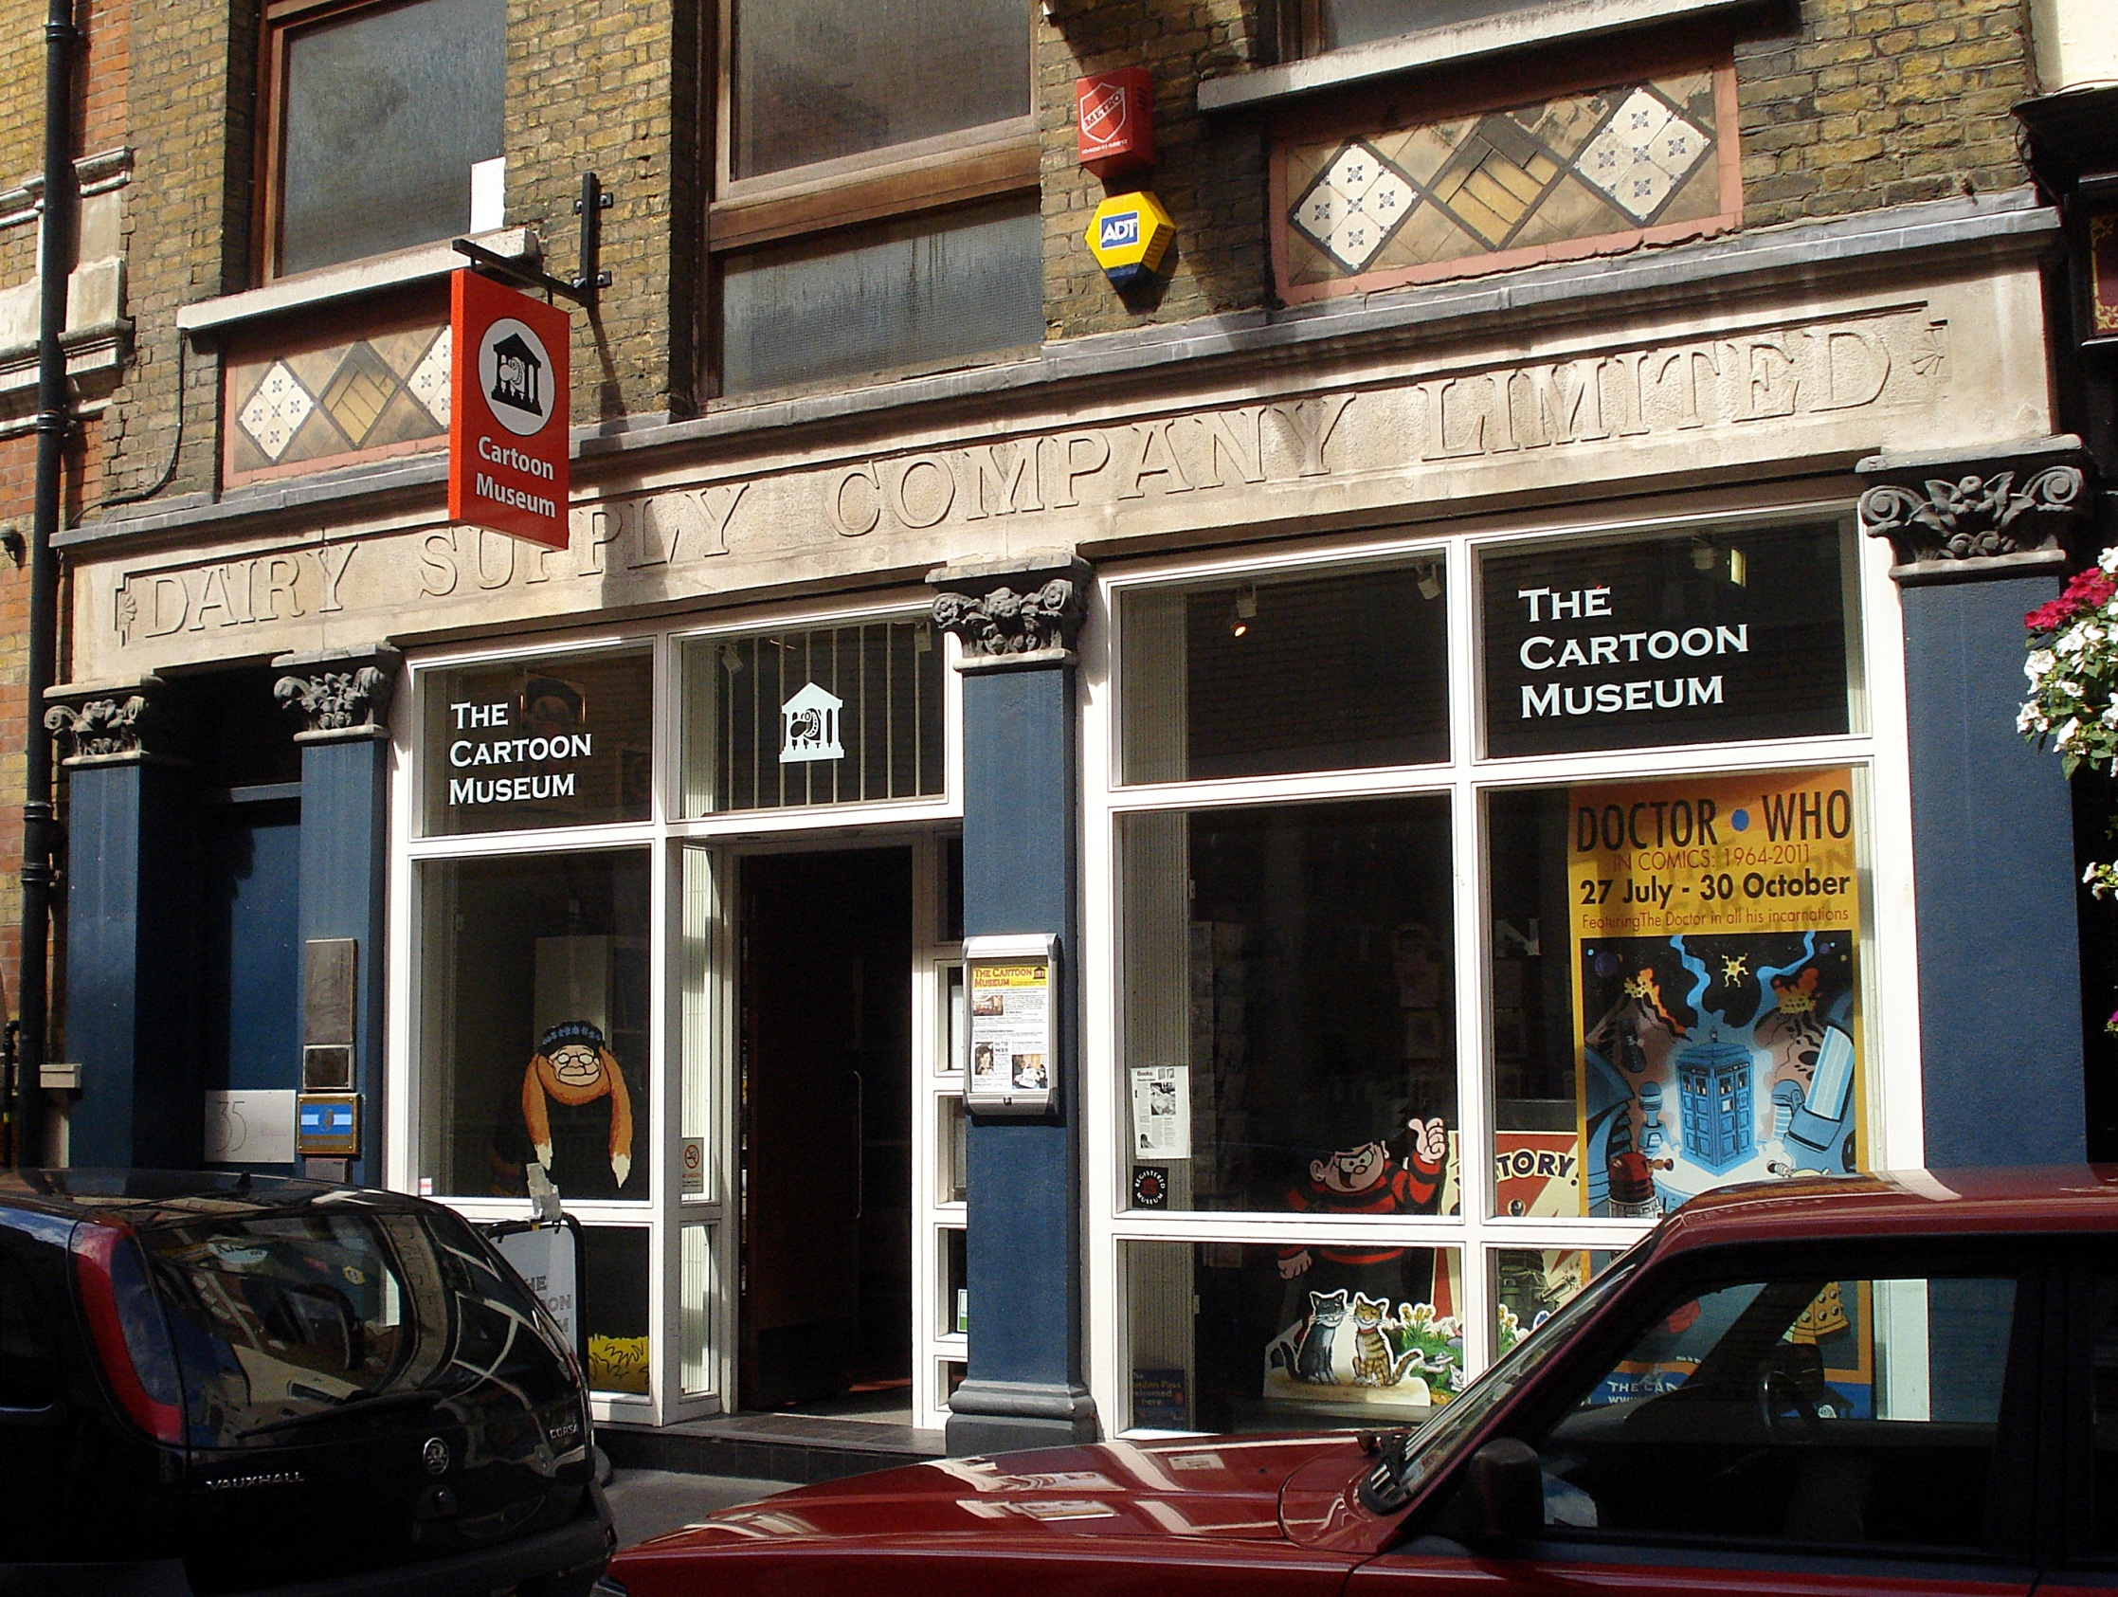
Cartoon Museum

Slide 11
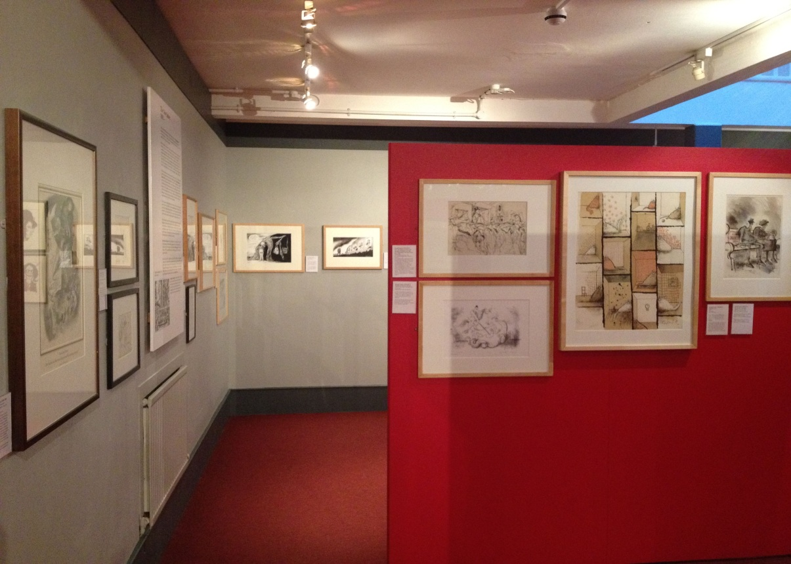
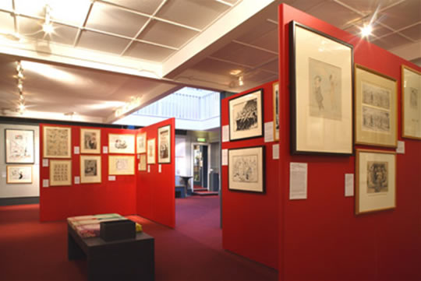
The Cartoon Museum is a London museum for British cartoons, caricatures, comic strips and animation. It has a library of over 5000 books and 4,000 comics relating to the subject.
The museum issues catalogues and features a changing display of over 250 exhibits from its collection of over 1700 original cartoons and prints.

Slide 12
In its mission statement, the museum declares it is "dedicated to preserving the best of British cartoons, caricatures, comics and animation, and to establishing a museum with a gallery, archives and innovative exhibitions to make the creativity of cartoon art past and present, accessible to all for the purposes of education, research and enjoyment."

Slide 13
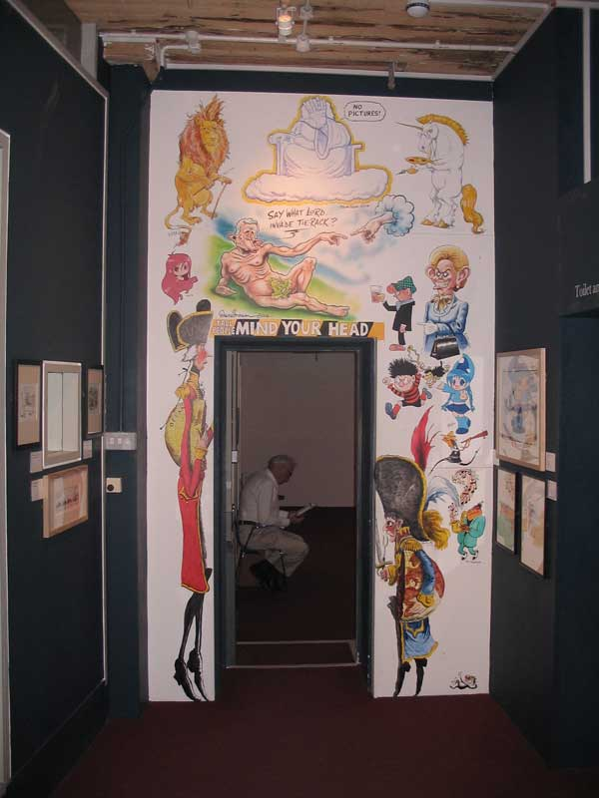

Slide 14
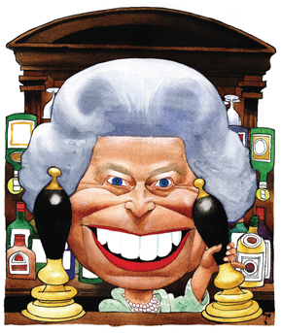

Slide 15
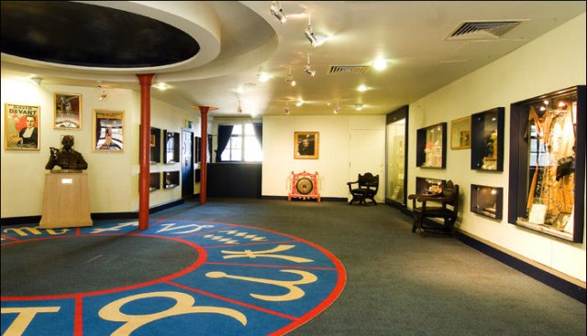
Magic Circle Museum

Slide 16
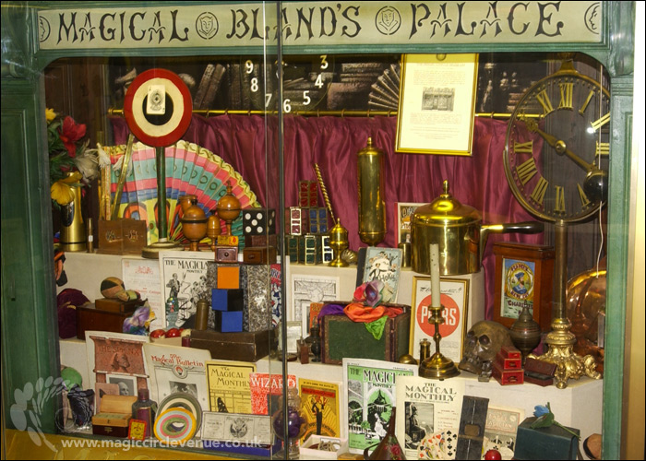
The Magic Circle was founded in 1905 after a meeting of 23 amateur and professional magicians at London's Pinoli's Restaurant. At this founders meeting, those present decided upon the name of the Society — it was initially felt that the name of the Society should be the Martin Chapender Club, in memory of the noted performer, and founding member, who had recently died at the age of twenty-five.

Slide 17
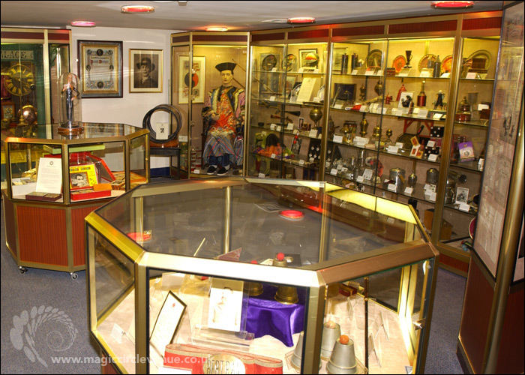
However, it was then agreed that the name "Magic Circle" would be more appropriate and that this name shared the same initials as those of Martin Chapender.The first official meeting was at the Green Man public house in Soho, but meetings were later in a room at St George's Hall in Langham Place, where David Devant and John Nevil Maskelyne were regularly seen performing.

Slide 18
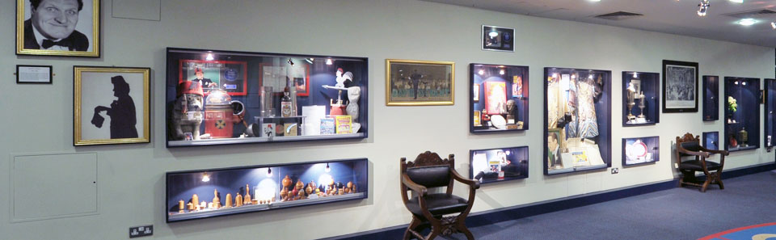

Slide 19
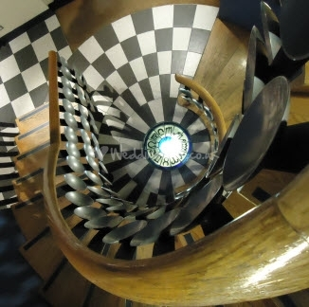

Slide 20
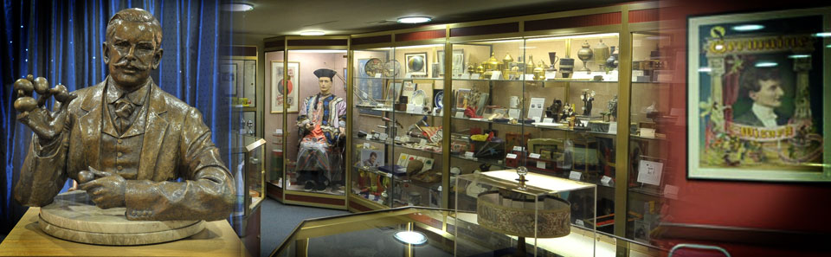
The museum features magic tricks, props, posters, programs, toys, photographs and artefacts related to conjuring history. Items of interest include, Robert Harbin’s original Zig Zag lady illusion, rifles used for the ‘Bullet Catch’ by Maurice Fogel in the 1940s, sets of props used by television magicians David Nixon and Tommy Cooper, items and a sound recording of Harry Houdini taken from an Edison cylinder, and a set of cups and balls used by HRH The Prince of Wales when he took his Magic Circle exam in 1975. Visits are by arranged tour.

Slide 21
