Slide 1
Презентация «INTERPOL» подготовлена студентами
четвертого курса факультета иностранных языков
специальности «Английский язык» при изучении темы
«Европейские и всемирные международные организации» под руководством
ст. преподавателя Гуд В.Г. .
Данная творческая работа может быть в дальнейшем использована в ходе изучения дисциплины
«Общественно-политический дискурс»
студентами 4 курса ф-та иностранных языков при ознакомлении с
темой «Международные организации и сообщества».

Slide 2
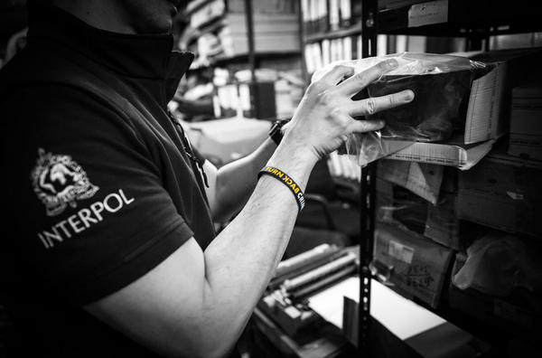

Slide 3
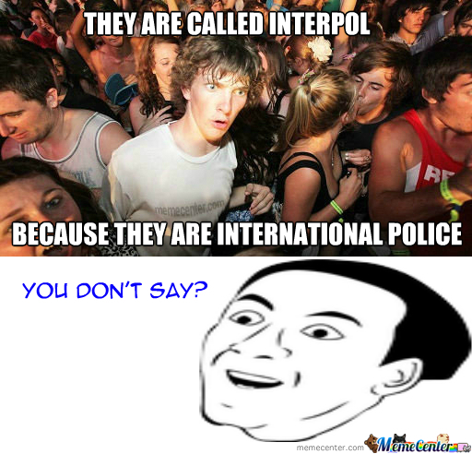
What is INTERPOL?
INTERPOL is the world’s largest international police organization, with 190 ﻿member countries.
Its role is to enable police around the world to work together to make the world a safer place.
Its high-tech infrastructure of technical and operational support helps meet the growing challenges of fighting crime in the 21st century.

Slide 4
VISION AND MISSION
The vision: "Connecting police for a safer world".
The mission: "Preventing and fighting crime through enhanced cooperation and innovation on police and security matters"

Slide 5
NEUTRALITY
INTERPOL aims to facilitate international police cooperation even where diplomatic relations do not exist between particular countries.
Action is taken within the limits of existing laws in different countries and in the spirit of the Universal Declaration of Human Rights. The Constitution of INTERPOL prohibits ‘any intervention or activities of a political, military, religious or racial character'.

Slide 6
A GLOBAL PRESENCE
The General Secretariat is located in Lyon, France, and operates 24 hours a day, 365 days a year.
INTERPOL also has seven regional offices across the world and a representative office at the United Nations in New York and at the European Union in Brussels.
Each of its 190 member countries maintains a National Central Bureau staffed by its own highly trained law enforcement officials.

Slide 7
SUPPORTING POLICE WORLDWIDE
INTERPOL works to ensure that police around the world have access to the tools and services necessary to do their jobs effectively.
Interpol's databases at the Lyon headquarters can assist law enforcement in fighting international crime.
Interpol’s databases can track criminals and crime trends around the world, specifically by means of collections of fingerprints and face photos, lists of wanted persons, DNA samples and travel documents.
Interpol’s lost and stolen travel document database alone contains more than 12 million records.
In the event of an international disaster, terrorist attack or assassination, Interpol can send an Incident Response Team (IRT).

Slide 8
EMBLEM
The current emblem of Interpol was adopted in 1950 and comprises the following elements:
the globe indicates worldwide activity
the olive branches represent peace
the sword represents police action
the scales signify justice

