Slide 1
Politically marked ceremonies and parliamentary conventions

Slide 2
Britain is a royal state which has preserved its ceremonies and traditions over hundreds of years. Some are every day and some are every year. Many of them are world famous and attract numerous tourists from all over the world.

Slide 3
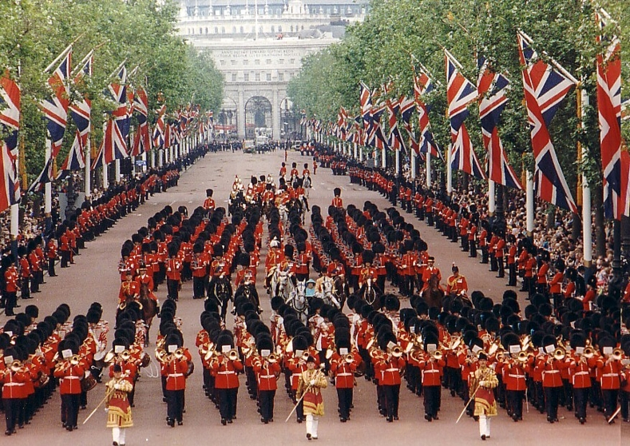
What is the Trooping the Colour?

Slide 4
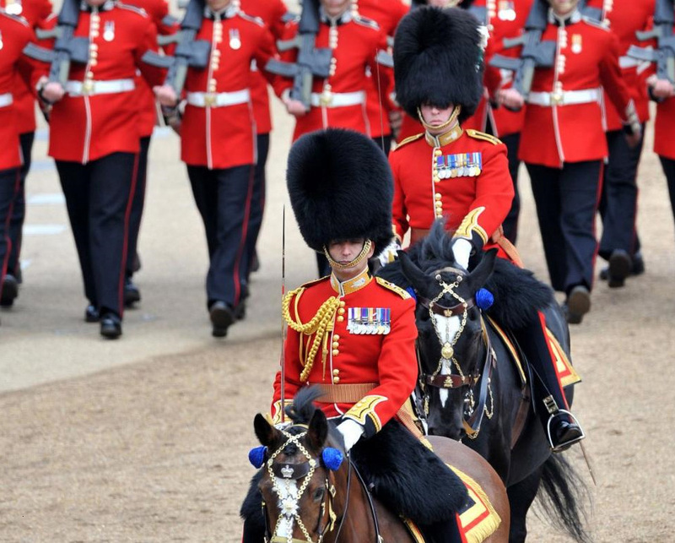

Slide 5
Trooping the Colour is a military ceremony performed by regiments of the Commonwealth and the British Army. It has been a tradition of British infantry regiments for centuries and it was first performed during the reign of Charles II.

Slide 6
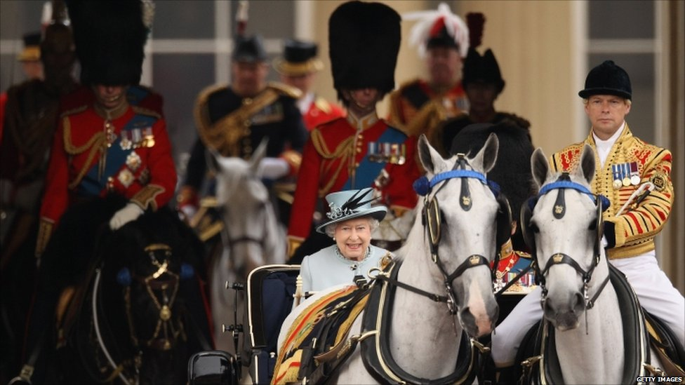
Since 1805 the ceremony has been carried out on the British Sovereign's birthday.

Slide 7
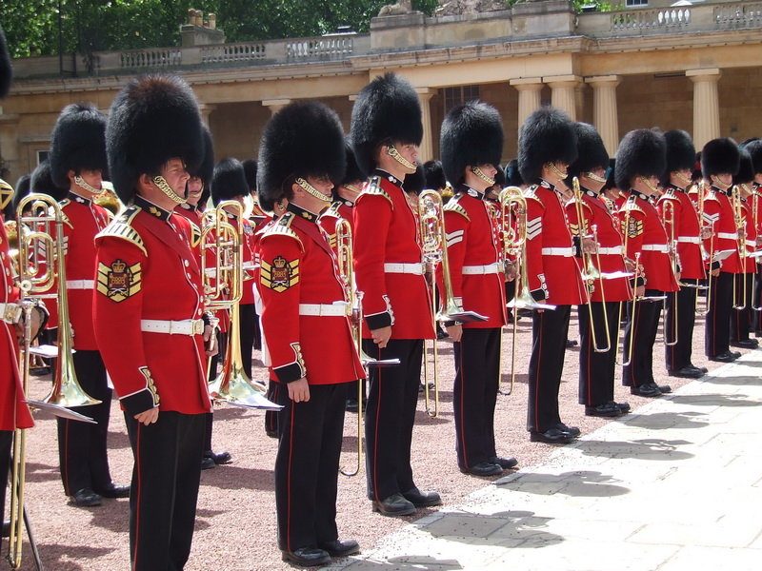
This military ceremony dates back to the early 18th century, when the colours (flag) of the battalion were carried (or ‘trooped’) down the ranks so that they could be seen and recognized by the soldiers.

Slide 8
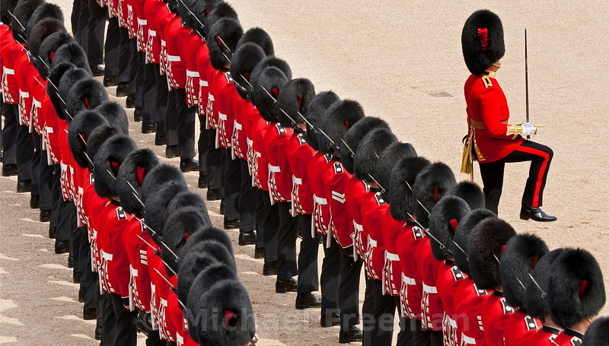
State Opening is the main ceremonial event of the parliamentary calendar, attracting large crowds, both in person and watching on television and the internet. The Queen's procession from Buckingham Palace to Westminster is escorted by the Household Cavalry.

Slide 9
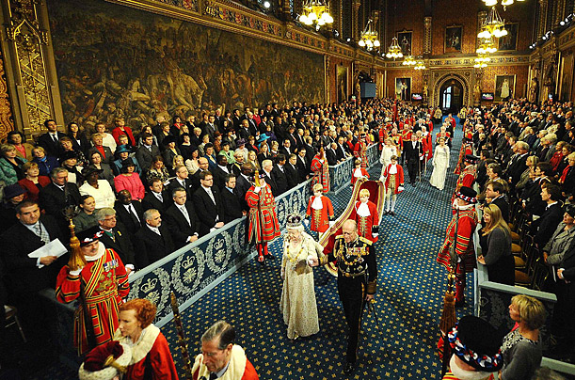
The State Opening of Parliament is the most colourful event of the Parliamentary year, which marks the beginning of the parliamentary session.

Slide 10
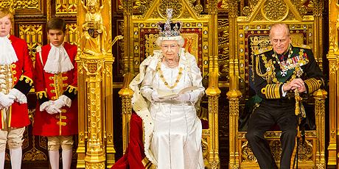
Its main purpose is for the monarch formally to open Parliament and, in the Queen's Speech, deliver an outline of the Government's proposed policies, legislation for the coming session and a review of the last session.

Slide 11
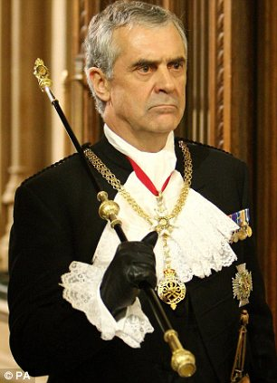
The official known as 'Black Rod‘ is sent to summon the Commons. In a symbol of the Commons' independence, the door to their chamber is slammed in Black Rod's face and not opened until Black Rod has knocked on the door with the staff of office. The Members of the House of Commons follow Black Rod and the Commons Speaker to the Lords Chamber and stand behind the Bar of the House of Lords ) to hear the Queen's Speech.

Slide 12
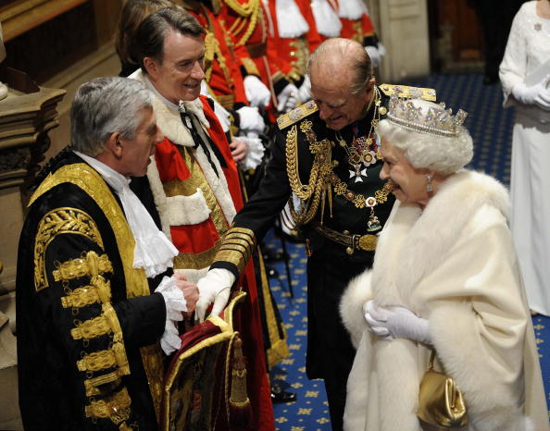
Traditions surrounding the State Opening and delivery of a speech by the monarch can be traced back at least to the 16th century.

Slide 13
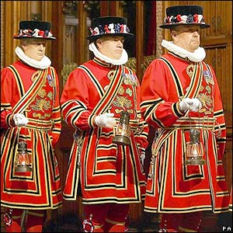
Before the opening of Parliament half a dozen "Beefeaters" the searching of the cellars underneath the Houses of Parliament, in memory of Guy Fawkes and the Gunpowder Plot in 1605.

Slide 14
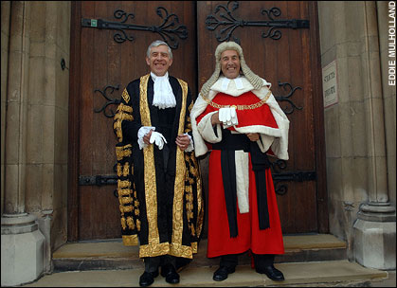
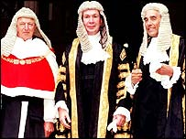
The Lord High Chancellor of Great Britain, or Lord Chancellor and in former times Chancellor of England, is one of the most senior and important functionaries in the government of the United Kingdom.

Slide 15
Before each day's sitting of the House of Lords, the Lord Chancellor forms part of a procession that marches from his residence to the Lords Chamber. The Lord Chancellor is preceded by the Deputy Serjeant-at-Arms or Principal Doorkeeper of the House and by the Purse-Bearer. The Lord Chancellor is followed by his Train-Bearer; the procession is later joined by the Gentleman Usher of the Black Rod. The Mace is placed on the Woolsack, where the Lord Chancellor sits after a bishop has led the House in prayers.

Slide 16
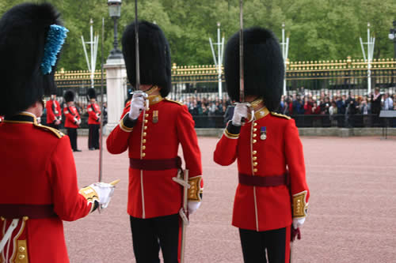
Changing the Guard or Guard Mounting is the process involving a new guard exchanging duty with the old guard.

Slide 17
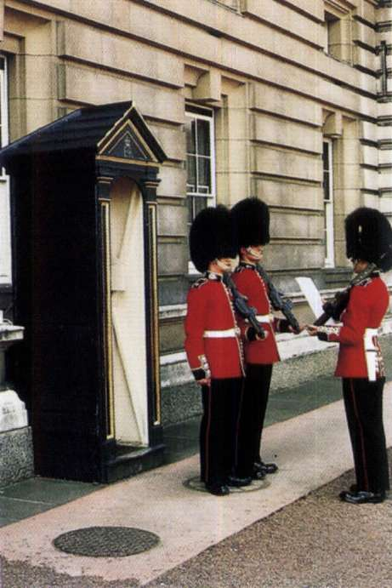
The changing of the guards takes place in the courtyard of Buckingham palace.
Briefly the procedure involves the new guard taking over duties from the old guard – however it is accompanied by lots of pomp, guards bands, military music and the ceremony of changing of the guard. The Queens guard provide a colourful display dressed in bearskins and red jackets.

Slide 18
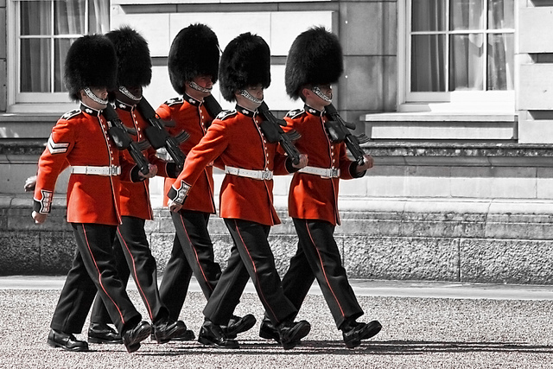

Slide 19
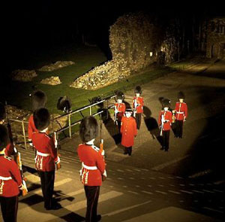
The Ceremony of the Keys

Slide 20
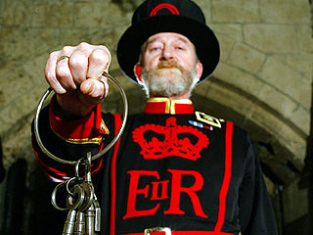
It takes place every night at the Tower of London, and has done so in some form or another since the 14th century.

Slide 21
Thank you for your attention
The end

