Slide 1
Constituent parts of national

Slide 2
New Year tree decorations
something used to decorate.

Slide 3
Trimmings
anything used or serving to decorate or complete: the trimmings of a Christmas tree.

Slide 4
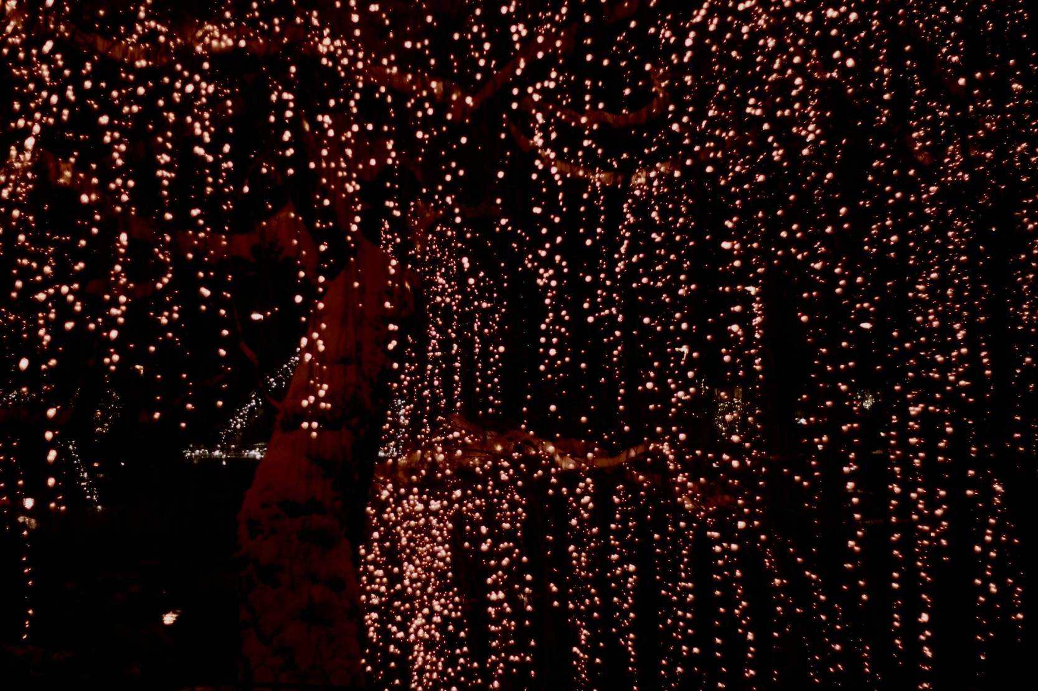
Small lights - little electric lamps that help to decorate trees, homes, apartments, windows ets.

Slide 5
Ornament(s) – 1)an accessory, article, or detail used to beautify the appearance of something to which it is added or of which it is a part.2)decorations collectively

Slide 6
Fairy lights
small coloured electric bulbs strung together and used for decoration, esp on a Christmas tree

Slide 7
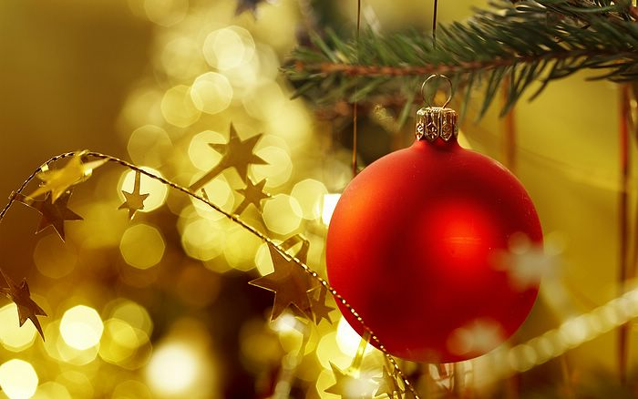
Bauble - a showy toy or trinket of little value; trifle

Slide 8
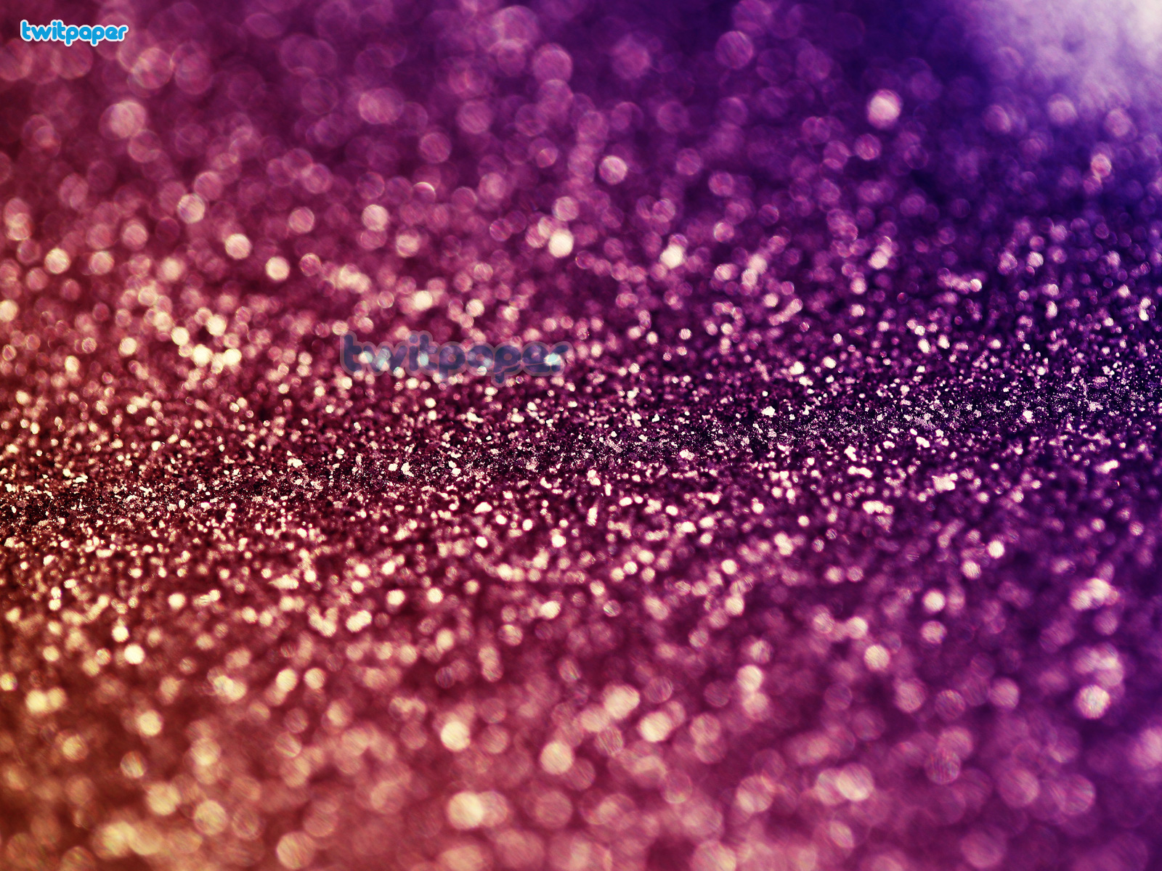
Glitter - 1)to reflect light with a brilliant, sparkling luster; sparkle with reflected light. 2.)to make a brilliant show.

Slide 9
Evergreen
1)(of trees, shrubs, etc.) having green leaves throughout the entire year, the leaves of the past season not being shed until after the new foliage has been completely formed. 2) remaining fresh and vital

Slide 10
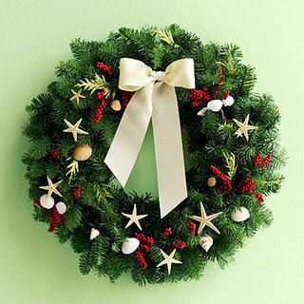
Wreaths of evergreen - a circular band of flowers, foliage, or any ornamental work, for adorning the head or for any decorative purpose; a garland or chaplet.

Slide 11
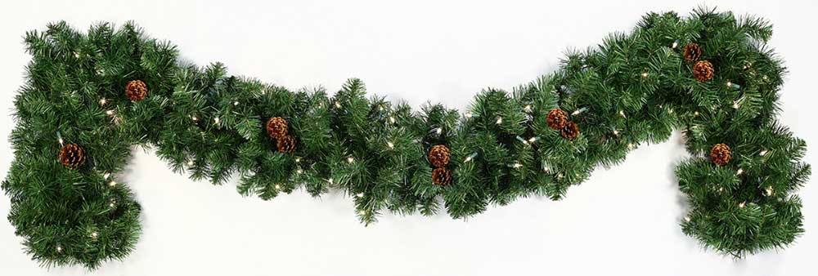
Garland - a wreath or festoon of flowers, leaves, or other material, worn for ornament or as an honor or hung on something as a decoration: A garland of laurel was placed on the winner's head.

Slide 12
Holly
the foliage and berries, used for decoration, especially during the Christmas season.

Slide 13
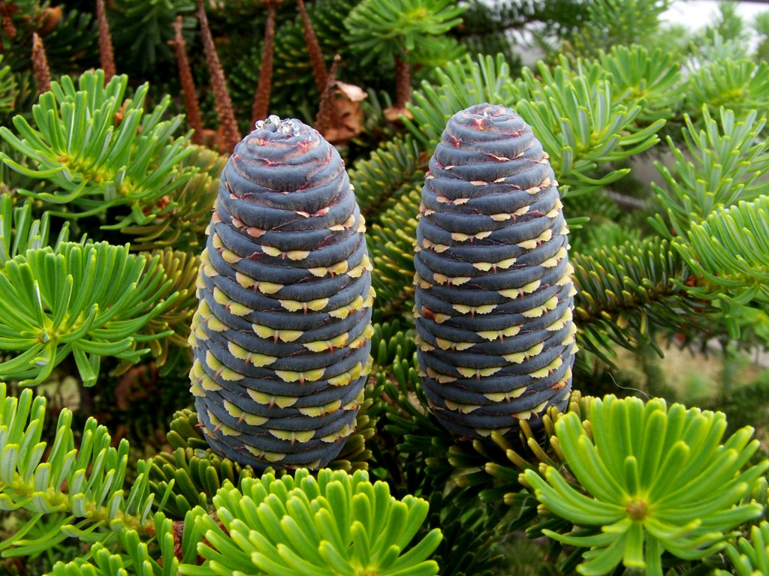
Fir cone - the seed-producing cone of a fir tree

Slide 14
Mistletoe
a European plant, Viscum album, having yellowish flowers and white berries, growing parasitically on various trees, used in Christmas decorations.

Slide 15
Bonfire – A large fire built outdoors, as for signaling or in celebration of an event.

