Slide 1
FOLKLORE

Slide 2
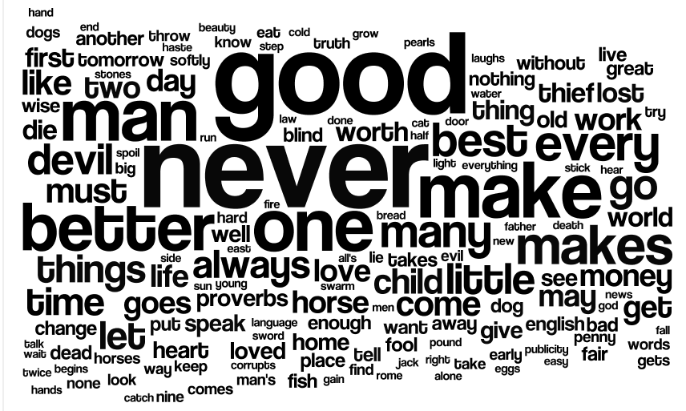
Proverb - a short, well-known pithy saying, stating a general truth or piece of advice.
An old Arab proverb says, `The enemy of my enemy is my friend'.

Slide 3
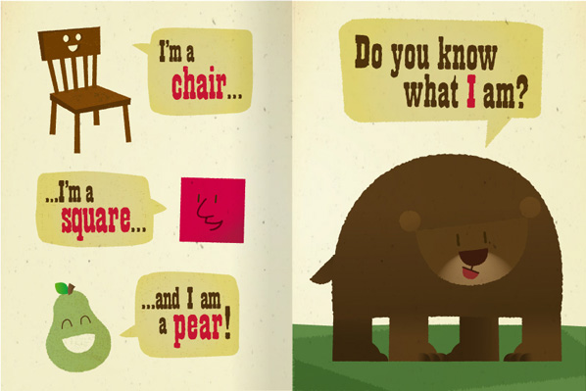
Rhyme - a short poem in which the sound of the word or syllable at the end of each line corresponds with that at the end of another.

Slide 4
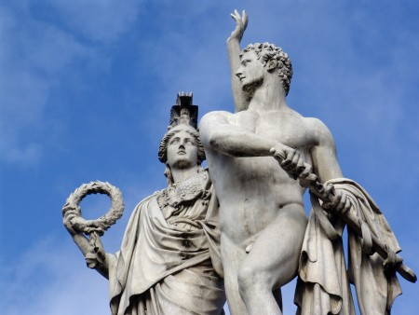
Myth - a traditional story, especially one concerning the early history of a people or explaining a natural or social phenomenon, and typically involving supernatural beings or events. Ancient Greek myths

Slide 5
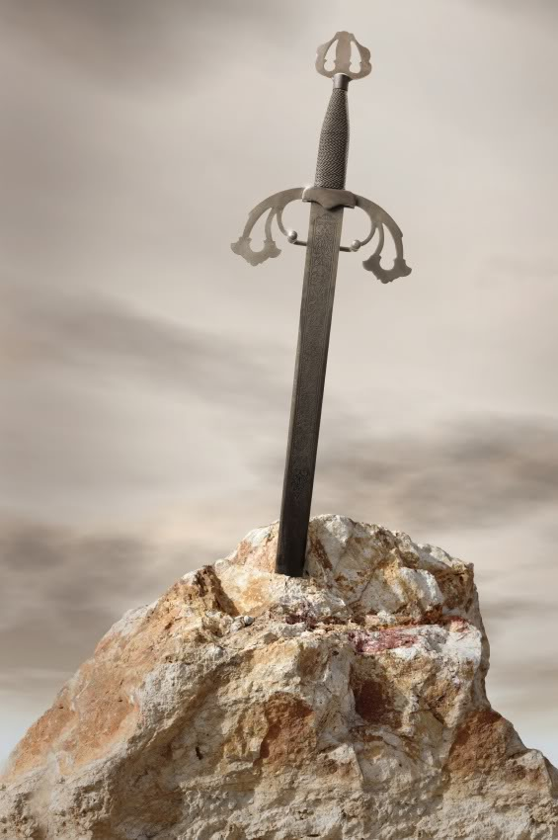
Legend - a traditional story sometimes popularly regarded as historical but not authenticated.
The legend of King Arthur

Slide 6
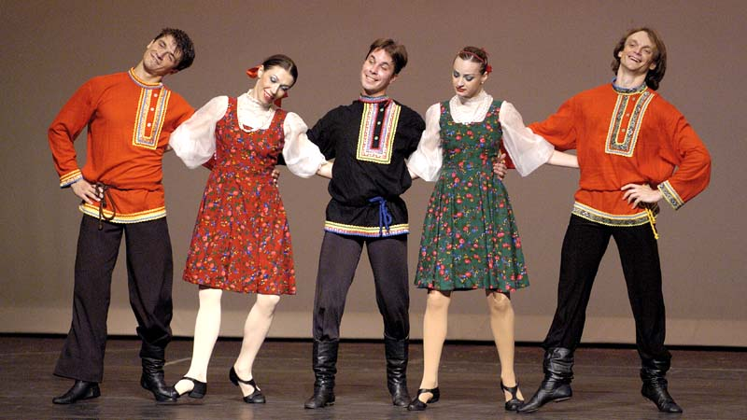
Folksong - a traditional song that is typical of a particular community or nation.
Folkdance - a popular dance considered as part of the tradition of a particular people or area.

Slide 7
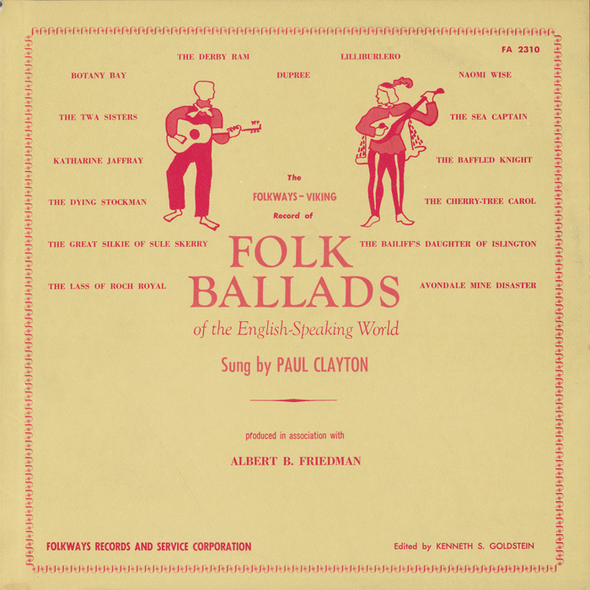
Ballad - a slow sentimental or romantic poem or song.

Slide 8
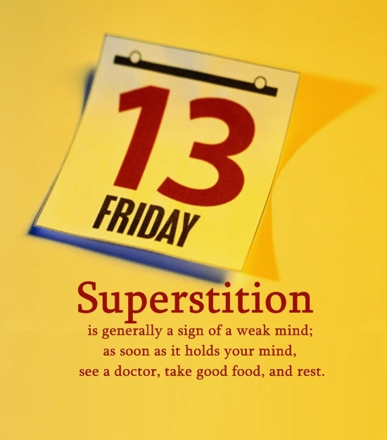
Superstition - a widely held but irrational belief in supernatural influences, especially as leading to good or bad luck, or a practice based on such a belief.

Slide 9
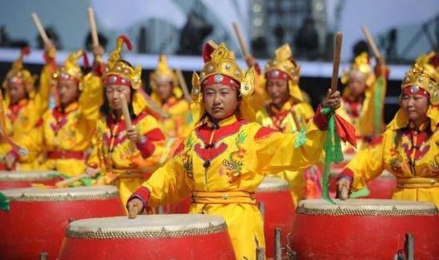
Custom - a traditional and widely accepted way of behaving or doing something that is specific to a particular society, place, or time.
Performers beat drums during a folk custom performance in China.

Slide 10
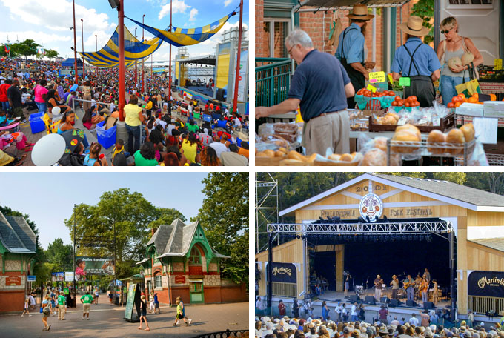
Festival - a day or period of celebration, typically for religious reasons.

Slide 11
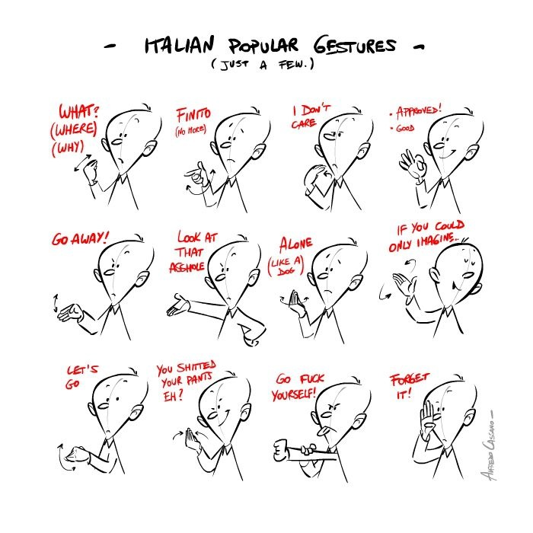
Folk gestures

Slide 12
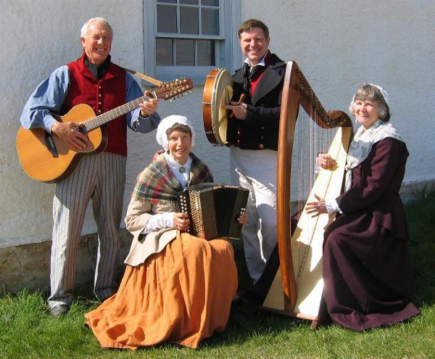
Folk music - music that originates in traditional popular culture or that is written in such a style. Folk music is typically of unknown authorship and is transmitted orally from generation to generation.
Traditional folk music of the British Isles.

Slide 13
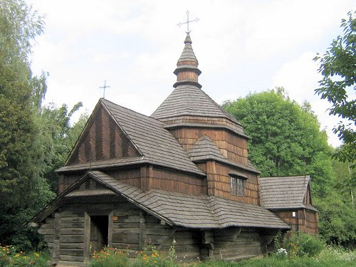
Folk architecture
Old wooden church, Ukrainian Folk architecture

Slide 14
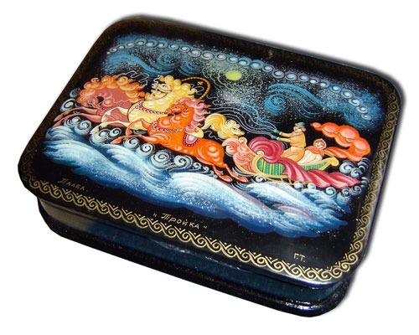
Handicraft - activities such as embroidery and pottery which involve making things with your hands in a skillful way.
Russian folk handicraft

Slide 15
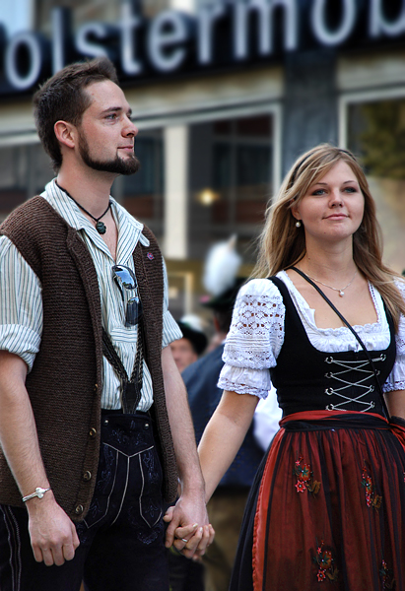
Folk costume
German folk costumes

Slide 16
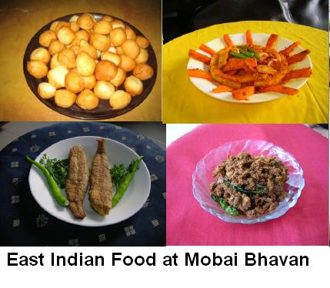
Folk food

