Slide 1
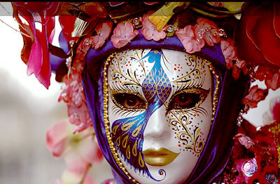
Activities in observance of holidays:
to mask:
1 cover (the face) with a mask: he had been masked, bound, and abducted
2 to cover with a decorative or protective mask: "Mask the children for Halloween"
3 make unrecognizable; "The herb masks the garlic taste"; "We disguised our faces before robbing the bank"

Slide 2
to observe
1 to keep or celebrate (a holiday, for example): observe an anniversary.
2 watch (someone or something) carefully and attentively:Rob stood in the hallway, from where he could observe the happenings on the street.
to celebrate
1 publicly acknowledge (a significant or happy day or event) with a social gathering or enjoyable activity:they were celebrating their wedding anniversary at a swanky restaurant;she celebrated with a glass of champagne
2 reach (a birthday or anniversary):the programme celebrates its 40th birthday this year

Slide 3
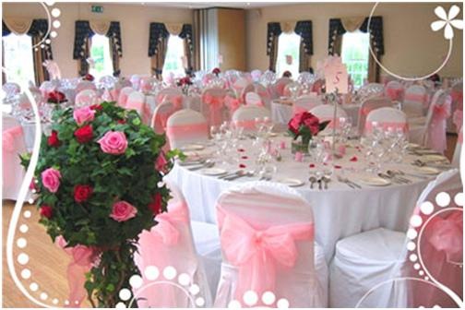
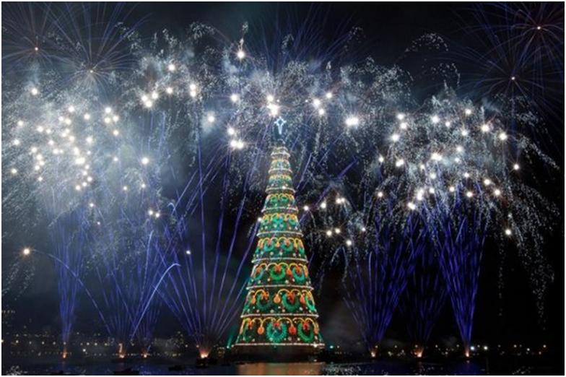
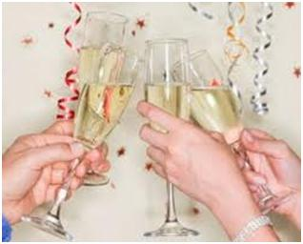

Slide 4
to commemorate
1 recall and show respect for (someone or something):a wreath-laying ceremony to commemorate the war dead
2 mark or celebrate (an event or person) by doing or producing something: the victory was commemorated in songs
to honour
1 regard with great respect: Joyce has now learned to honour her father’s memory
2 pay public respect to: talented writers were honoured at a special ceremony.

Slide 5
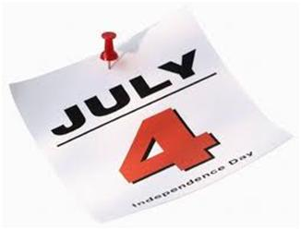
a date
1. Time stated in terms of the day, month, and year.
2. A specified day of a month.
3. A particular point or period of time at which something happened or existed, or is expected to happen.

Slide 6
to keep
1.To celebrate; observe.
to preserve a tradition
1. To keep in perfect or unaltered condition; maintain unchanged.

Slide 7
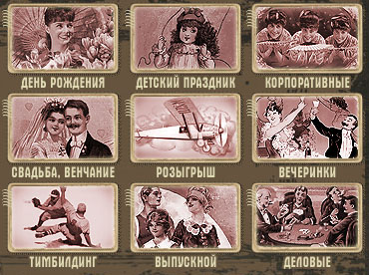
to organize
1 make arrangements or preparations for (an event or activity)

Slide 8
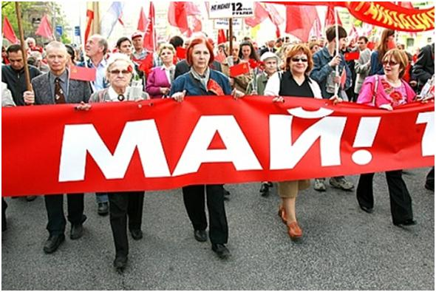
to sponsor a parade
1 support materially or financially
a demonstration
1 a show or display; the act of presenting something to sight or view

Slide 9
to give a party (to throw a party) (colloq.)
‘I must get back soon,’ she said. ‘They're throwing a party for me...’ (S. Heym, ‘The Crusaders’, book I, ch. 4) — - Мне пора идти, - сказала Карен. - Они там вечеринку устраивают для меня.
to demonstrate labour solidarity
unity or agreement of feeling or action, especially among individuals with a common interest; mutual support within a group

Slide 10
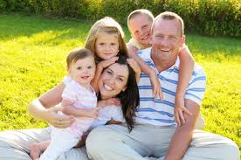
to have family get together

Slide 11
merry-making 1. Participation in festive activities.
2. A festivity; a revelry; Festive activities.
to give presents (BE),
1. a thing presented as a gift: Christmas presents.
gifts (AE);
1.something given voluntarily without payment in return, as toshow favor toward someone, honor an occasion, or make agesture of assistance; present.

Slide 12
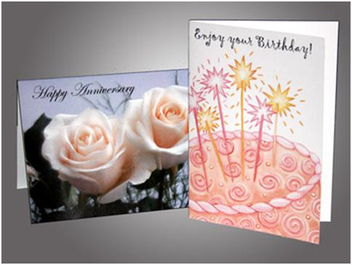
to send greeting cards
1.a decorative card sent to convey good wishes.

Slide 13
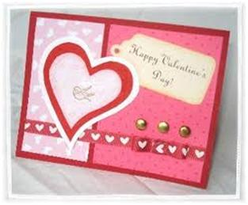
Valentine cards
Valentine's Day - a day for the exchange of tokens of affection

Slide 14
to go treat or tricking
1) a celebration, entertainment, gift, or feast given for or to someone and paid for by another 2) any delightful surprise or specially pleasant occasion 3) the act of treating
to ask a penny for the guy;
British phrase that kids ask their neighbors-similar to USA's "Trick or Treat"-because they need money for the Guy Fawkes dummy that they are making for the parade and bonfire.
(knock knock on door) " 'ello then and what ye need?" " Penny for the Guy?" " The' ye ar' " "Thanks mista' "
to have bonfires
to lay wreaths.

