Slide 1
Alfred the Great

Slide 2
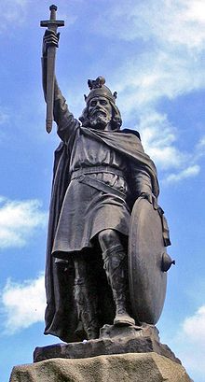
Alfred was born in the village of Wanating, now Wantage, Oxfordshire. He was the youngest son of King.
Alfred the Great was King of Wessex from 871 to 899.

Slide 3
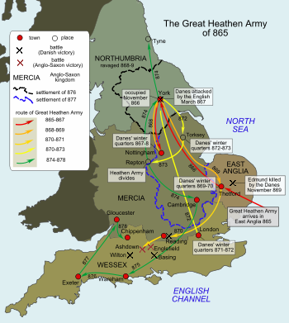
.
In April 871, King Ethelred died, and Alfred succeeded to the throne of Wessex and the burden of its defence, despite the fact that Ethelred left two under-age sons, Ethelhelm and Ethelwold. This was in accordance with the agreement that Ethelred and Alfred had made earlier that year in an assembly at Swinbeorg. The brothers had agreed that whichever of them outlived the other would inherit the personal property that King Ethelwulf had left jointly to his sons in his will.

Slide 4
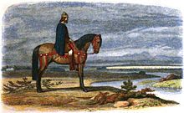
Counterattack and victory
Alfred won a decisive victory in the ensuing Battle of Ethandun, which may have been fought near Westbury, Wiltshire. He then pursued the Danes to their stronghold at Chippenham and starved them into submission. One of the terms of the surrender was that Guthrum convert to Christianity; and three weeks later the Danish king and 29 of his chief men were baptised at Alfred's court at Aller, near Athelney, with Alfred receiving Guthrum as his spiritual son.

Slide 5
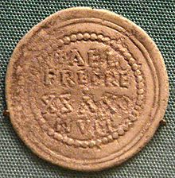
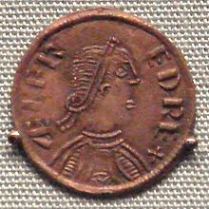
Further Viking attacks repelled
After another lull, in the autumn of 892 or 893, the Danes attacked again. Finding their position in mainland Europe precarious, they crossed to England in 330 ships in two divisions. They entrenched themselves, the larger body at Appledore, Kent, and the lesser, under Hastein, at Milton, also in Kent. The invaders brought their wives and children with them, indicating a meaningful attempt at conquest and colonisation. Alfred, in 893 or 894, took up a position from which he could observe both forces. While he was in talks with Hastein, the Danes at Appledore broke out and struck northwestwards.

Slide 6
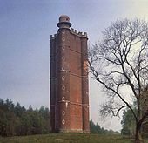
Military reorganisation
Alfred determined their strategy was to launch smaller scaled attacks from a secure and reinforced defensible base which they could retreat to should their raiders meet strong resistance. These bases were prepared in advance, often by capturing an estate and augmenting its defences with surrounding ditches, ramparts and palisades. Once inside the fortification, Alfred realised, the Danes enjoyed the advantage, better situated to outlast their opponents or crush them with a counter attack as the provisions and stamina of the besieging forces waned.
King Alfred's Tower (1772) on the supposed site of Egbert's Stone, the mustering place before the Battle of Ethandun.

Slide 7
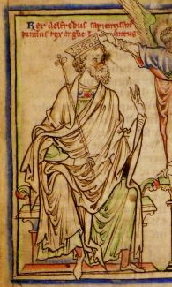
Burghal system
The size of the burhs ranged from tiny outposts such as Pilton to large fortifications in established towns, the largest at Winchester.[38] Many of the burhs were twin towns that straddled a river and connected by a fortified bridge, like those built by Charles the Bald a generation before. The double-burh blocked passage on the river, forcing Viking ships to navigate under a garrisoned bridge lined with men armed with stones, spears, or arrows. Other burhs were sited near fortified royal villas allowing the king better control over his strongholds.

Slide 8
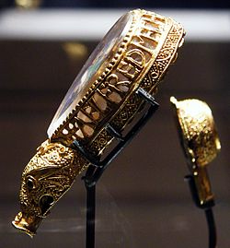
Administration and taxation
The allotments of the Burghal Hidage represent the creation of administrative districts for the support of the burhs. The landowners attached to Wallingford, for example, were responsible for producing and feeding 2,400 men, the number sufficient for maintaining 9,900 feet (3.0 kilometres) of wall. Each of the larger burhs became the centre of a territorial district of considerable size, carved out of the neighbouring countryside in order to support the town. In one sense, Alfred conceived nothing truly new here.
The Alfred Jewel, in the Ashmolean Museum, Oxford, commissioned by Alfred

Slide 9
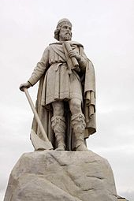
Legal reform
In the late 880s or early 890s, Alfred issued a long domboc or law code, consisting of his "own" laws followed by a code issued by his late seventh-century predecessor King Ine of Wessex. Together these laws are arranged into 120 chapters. In his introduction, Alfred explains that he gathered together the laws he found in many "synod-books" and "ordered to be written many of the ones that our forefathers observed—those that pleased me; and many of the ones that did not please me, I rejected with the advice of my councillors, and commanded them to be observed in a different way.

