Slide 1
Eating and Drinking
Traditions in Britain

Slide 2
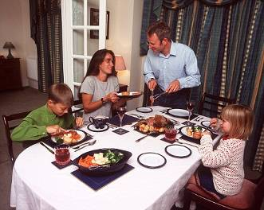
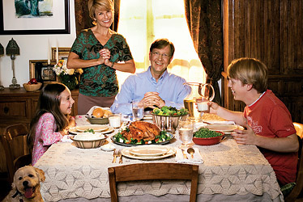
The English proverb says:
“Every cook praises his own broth”.
(Всякий повар свою стряпню хвалит)
One can not say English cookery is bad, but there is not a lot of variety in it, in comparison with Europe cuisine. The English are very particular about their meal.

Slide 3
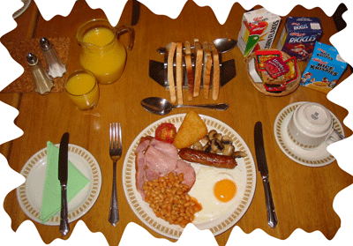
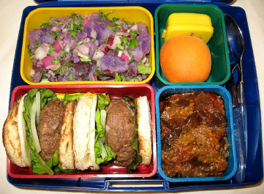
The usual meals in England are:
Breakfast – between 7 a.m. and 9 a.m.
Lunch – between 12:00 and 1:30 p.m.
Afternoon tea – between 3 p.m. and 5 p.m.
Dinner (supper) – between 6 p.m. and 8 p.m.

Slide 4
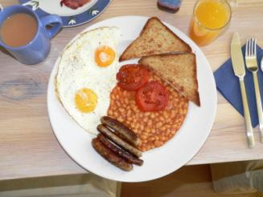
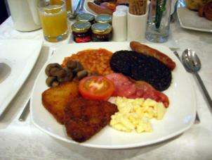
The Traditional English Breakfast
Traditionally, people in Britain have enjoyed a substantial hot meal for breakfast, featuring eggs, bacon, and sausage, accompanied by toast and tea or coffee. Many other items (kedgeree (блюдо из рыбы), grilled or fried tomatoes, baked beans, fried sliced bread, fried potato and mushrooms) may be included depending on taste and location.
The traditional English breakfast is called the 'Full English' and sometimes referred to as 'The Full English Fry-up‘.

Slide 5
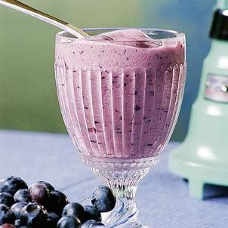
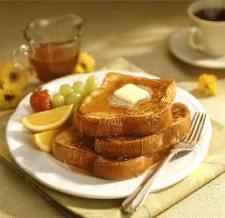
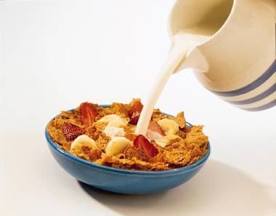
Today, this dish is not usually served at breakfast time during the week. The traditional cooked breakfast has largely been replaced by simple, light foods mainly eaten cold: fruit, yogurt, packaged cereal with cold milk, and toast with a variety of spreads such as butter, jam, marmalade.

Slide 6
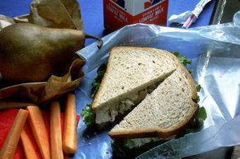
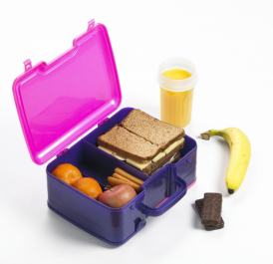
Many people eat lunch while at work or school. Employers and schools usually provide a lunch break in the middle of the day, lasting as much as an hour. Some factories and schools have canteens where you can eat.
But the packed lunch is the most common thing to eat. A packed lunch normally consists of some sandwiches, a packet of crisps, an apple and a can of something to drink, for example, coca-cola. The contents are kept in a plastic container and you take it with you when you go to school or work.

Slide 7
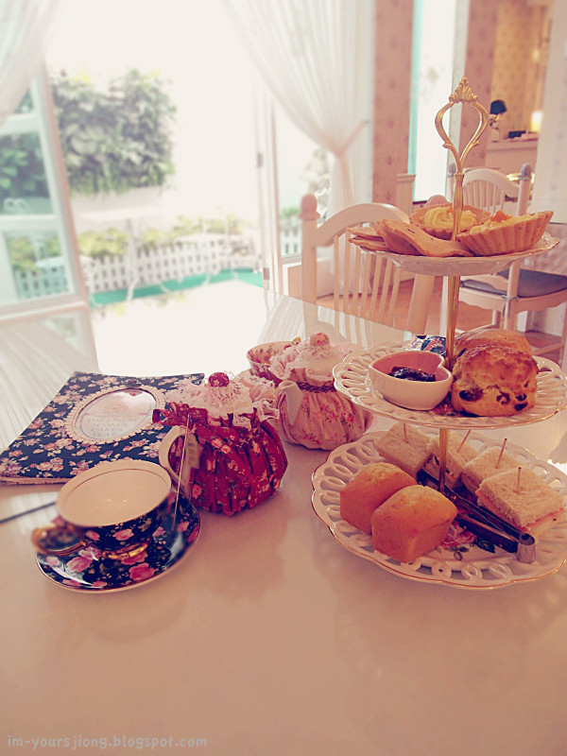
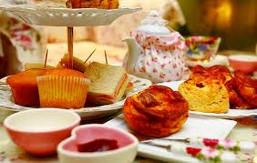
Tea is very popular among the English; it may almost be called their national drink. The English like it strong and fresh made. The English put one teaspoon of tea for each person. Tea means two things. It is a drink and a meal. Traditionally, loose tea would be served in a teapot with milk and sugar.
This would be accompanied by various sandwiches, scones (лепешки) and usually cakes and pastries (мучные изделия). The food would be often served in a tiered (многоярусное) stand.

Slide 8
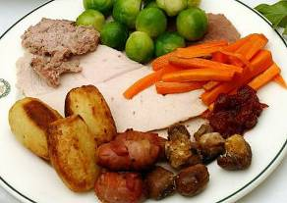
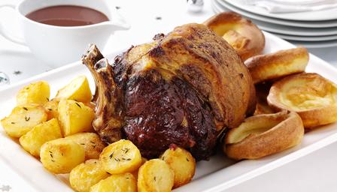
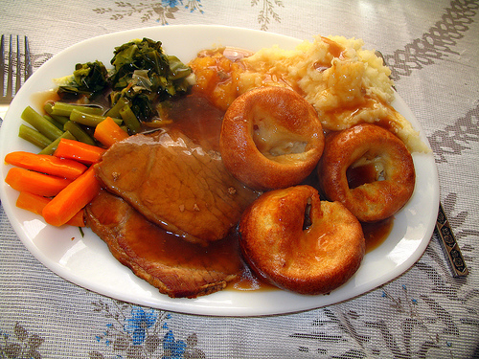
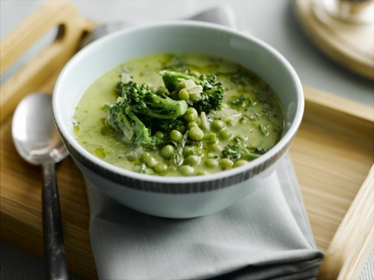
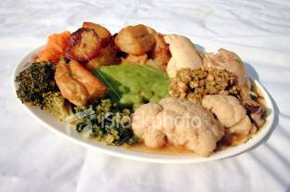
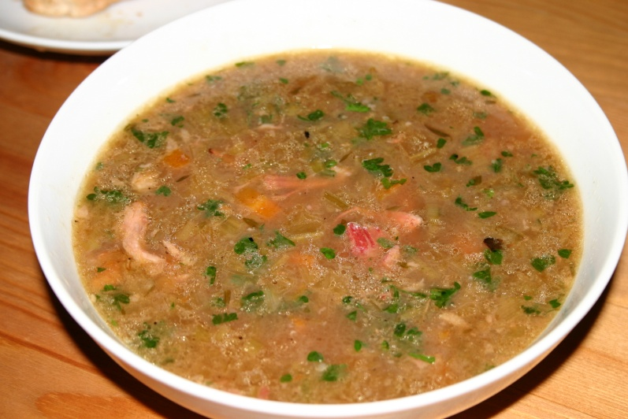
Dinner – the evening meal – is the biggest and the main meal of the day. It begins with soup.
The most typical thing to eat for dinner is "meat and two vegs". This consists of a piece of meat accompanied by two different boiled vegetables. One of the vegetables is almost always potatoes. The British eat a lot of potatoes.

Slide 9
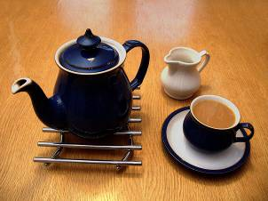
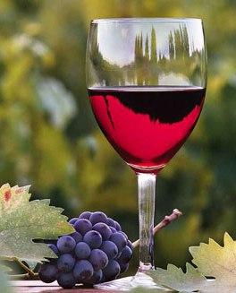
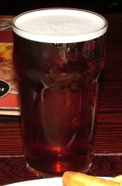
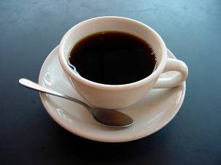
Traditional Drinks in England
Tea
Coffee
Bitter
Wine

Slide 10
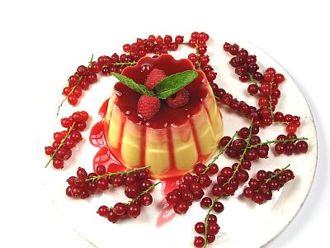
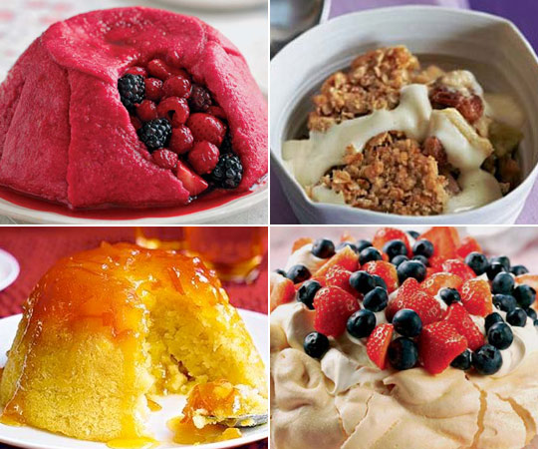
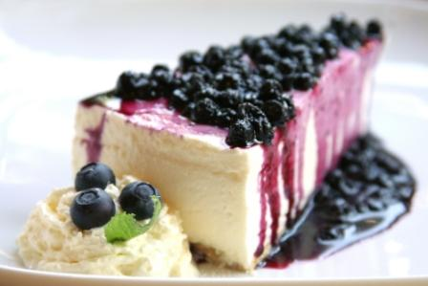
English Puddings and Desserts
What is a Pudding ? A pudding is the dessert course of a meal (‘pud’ is used informally). In Britain, they also use the words ‘dessert’, ‘sweet‘’ and ‘afters’.

Slide 11
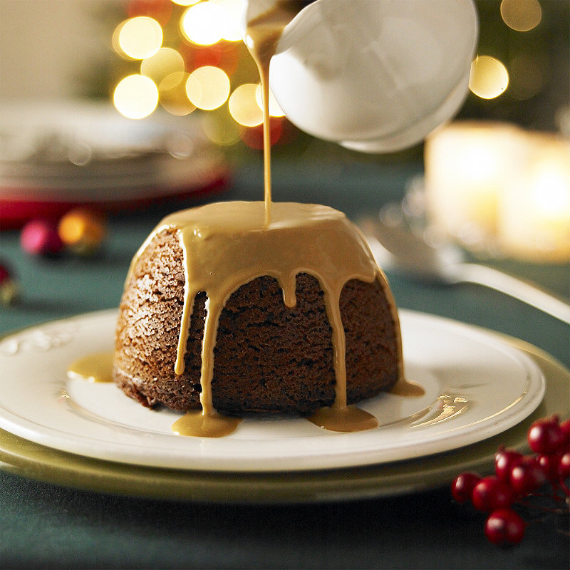
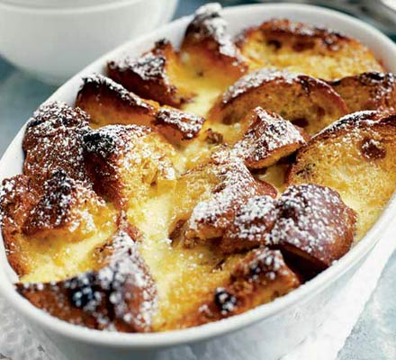
There are hundreds of variations of sweet puddings in England but each pudding begins with the same basic ingredients of milk, sugar, eggs, flour and butter. Many of the puddings involve fresh fruit such as raspberries (малина) or strawberries, custard (заварной крем), cream, and cakes.
Bread and butter pudding is old English favourite food

Slide 12
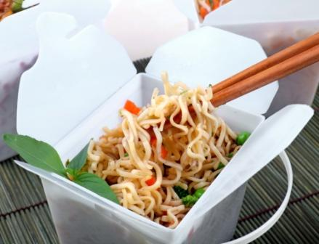
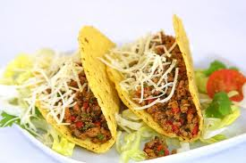
Take away food. (Eat out food)
Take-away meals became very popular and most towns have a selection of Indian, Italian, Chinese and Greek Restaurants. You will also find MacDonald’s, Burger King and Subway.

Slide 13
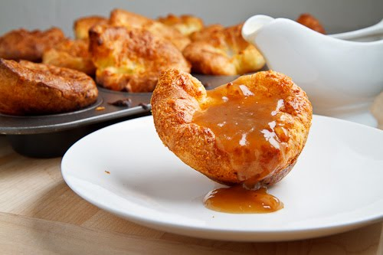
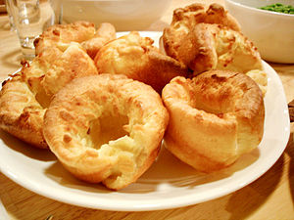
Yorkshire Pudding, also known as batter pudding, is an English dish made from batter and usually served with roast meat and gravy.
The Yorkshire pudding is a staple of the British Sunday lunch and in some cases is eaten as a separate course prior to the main meat dish.Traditionally, though less so now, the Yorkshire Pudding could be served as a sweet, with sugar or even with orange juice as a sauce.

Slide 14
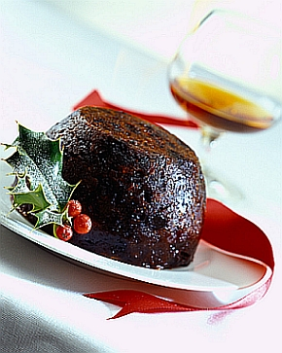
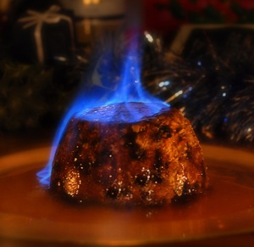
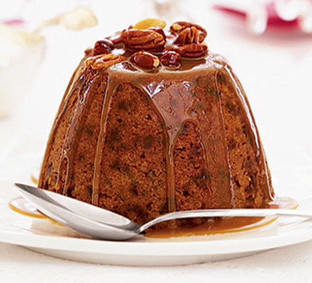
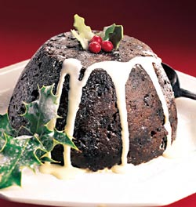
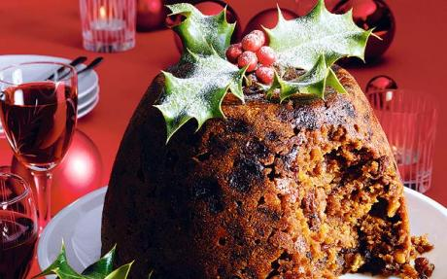
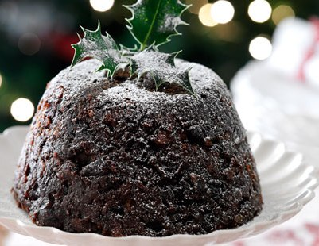
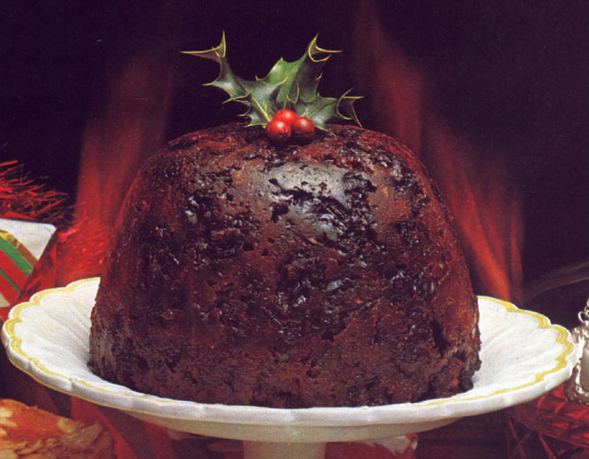
Christmas pudding is a type of pudding traditionally served on Christmas Day (December 25) as part of the Christmas Dinner. It has its origins in medieval England, and is sometimes known as plum pudding or Christmas Pudding or just "pud", though this can also refer to other kinds of boiled pudding involving dried fruit. Despite the name "plum pudding," the pudding contains no actual plums due to the pre-Victorian use of the word " plums" as a term for raisins.

Slide 15
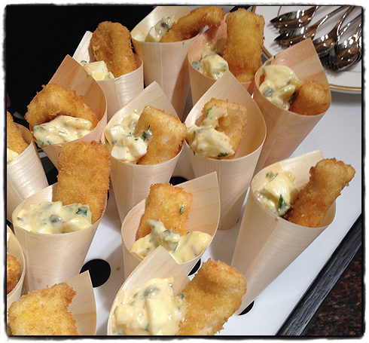
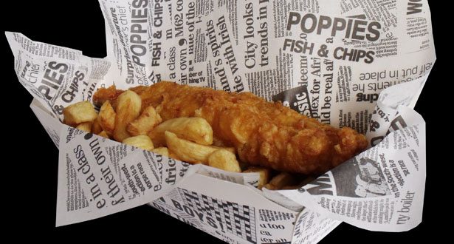
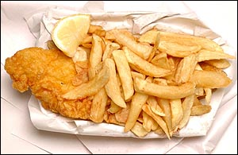
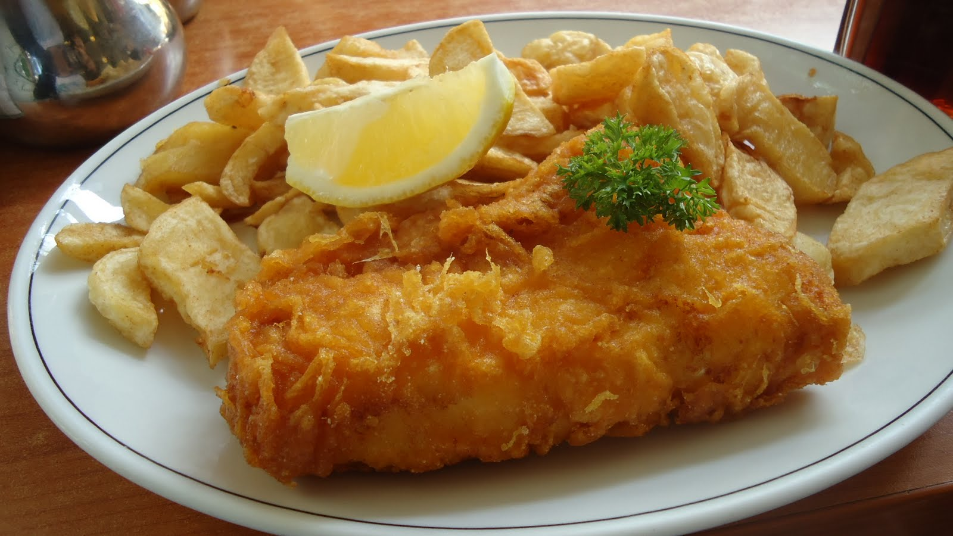
Fish and chips is a take-away food which consists of battered fish and deep-fried chips, sometimes accompanied by mushy peas and tartar sause. The dish originated in Great Britain in the 19th century. Fish and chips became a stock meal among the working classes in Great Britain. In 1860, the first fish and chip shop was opened in London. The modern fish-and-chip shop calls "chippy“.

Slide 16
The End
Thank You for Your Attention

