Slide 1
British Hip hop music

Slide 2
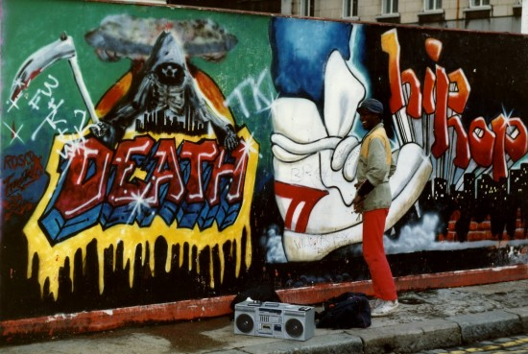
British hip hop is a genre of music, and a culture that covers a variety of styles of hip hop music made in Scotland, England, Wales and Northern Ireland.

Slide 3
It is generally classified as one of a number of styles of urban music. British hip hop was originally influenced by the dub/toasting introduced to the United Kingdom by Jamaican immigrants in the 1960s–70s.

Slide 4
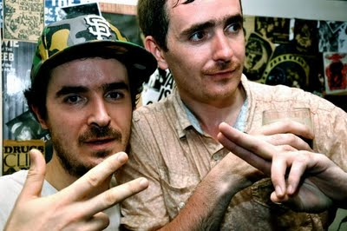
Task Force are a British hip hop group from Highbury in London, England. The group is led primarily by two brothers Chester P (vocals, song writing and occasional music production) and Farma G (vocals, song writing and music production).

Slide 5
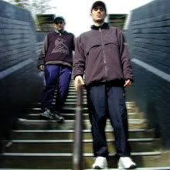
Task Force officially formed in 1999, releasing their debut album New Mic Order.
Task Force's debut album, New Mic Order, was produced by Mark B and features guest appearances from fellow Mud Family member Skinnyman and Mr. Thing of the Scratch Perverts. Task Force's releases have consisted for the most part of vinyl-only EPs and singles. In 2000, Task Force released Voice of the Great Outdoors, which featured Braintax and Jehst, on Braintax's Low Life Records.

Slide 6
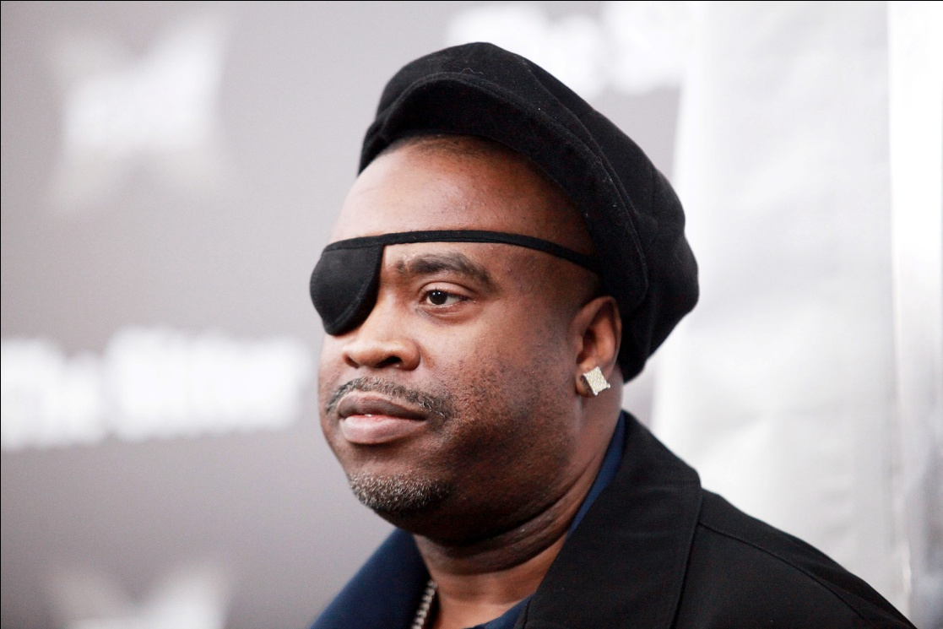
Richard Walters (born 14 January 1965), better known by his stage name Slick Rick, is a Grammy-nominated English rapper. He has also been known as Rick the Ruler. He began his career in late 1983, in the hip hop genre, where he recorded a series of acclaimed recordings such as "La Di Da Di" and "Children's Story". He is known for the use of narrative in his raps and has been called "hip hop's greatest storyteller

Slide 7
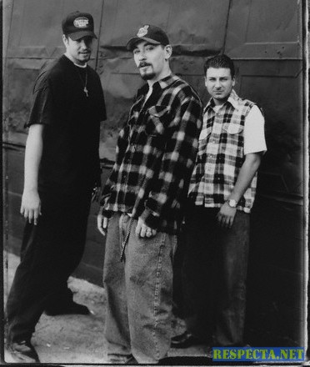
House of Pain is an American hip hop group who released three albums in the 1990s before lead rapper Everlast left to pursue his solo career. The group's name is a reference to the H.G. Wells novel The Island of Dr. Moreau

Slide 8
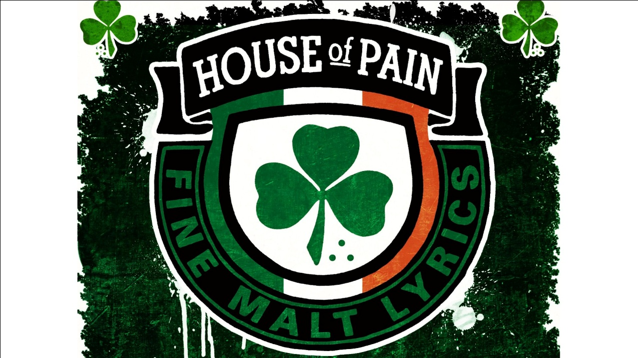
The group is best known for its 1992 hit single "Jump Around", which reached number 3 in the United States, number 6 in Ireland and number 8 in the United Kingdom. The group broke up in 1996 but reformed in 2010, after the trio had been members of supergroup La Coka Nostra for several years.

Slide 9

Estelle Fanta Swaray (born 18 January 1980[1][2]) commonly known as Estelle, and formerly as Est'elle, is an English R&B singer-songwriter, rapper and record producer. Estelle was born in London. After meeting John Legend, Estelle signed a record deal with V2 and Atlantic Records.

Slide 10
In 2004 Estelle released her debut album The 18th Day, which peaked within the top 40 of the official UK charts. The album released three singles "1980", "Free", and "Go Gone" which all charted within the top 40 also of the UK charts. In 2008 Estelle released her second studio album Shine which was certified Gold in the UK.

Slide 11
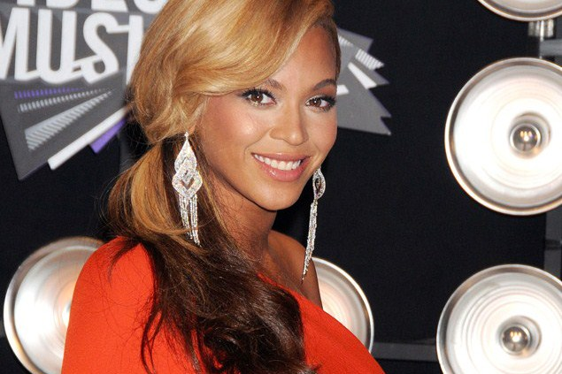
Baby Blue (born Rachel Johnson), is an English rapper and singer in London, England. She is known for her work with singer Estelle and collaborations with John Legend, Madness, Sway, Shystie, Ms. Dynamite and Lady Sovereign. Baby Blue has a sound that fuses hip hop with grime, R&B and soul.

Slide 12
Baby Blue started rapping while at school and eventually recorded a track called 'I Woulda', which was inspired by her cousin's gang-related death in the US. The track received heavy rotation and was the start of Baby Blue's career as a recording artist. When she was 19 she sent her music to UK artist Estelle, who immediately invited Baby Blue to New York to record the song 'Hey Girl' featuring John Legend, as well as 'Don't Talk', another track for Estelle's début album The 18th Day, which was certified gold in the UK and she was also featured rapping in the video for the hit top 20 track 1980

