Slide 1
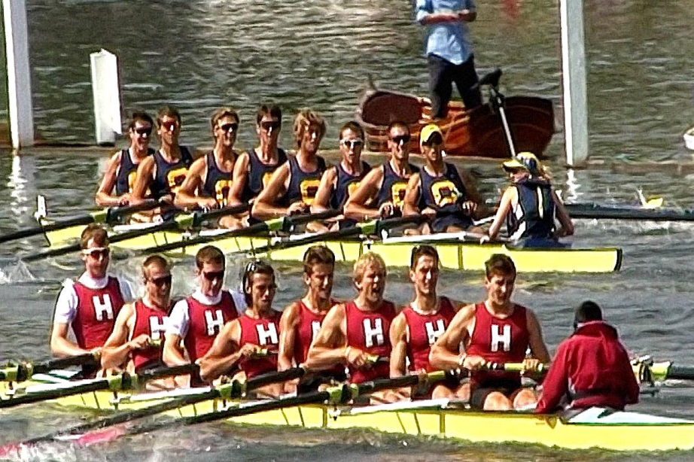
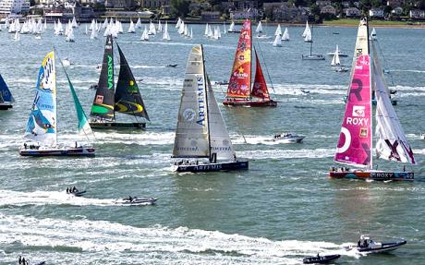
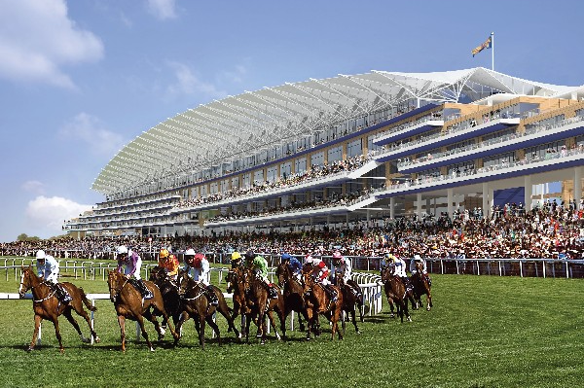
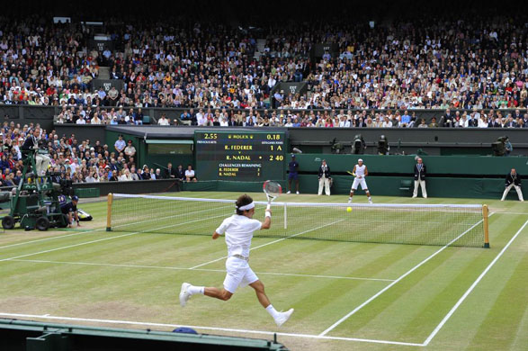
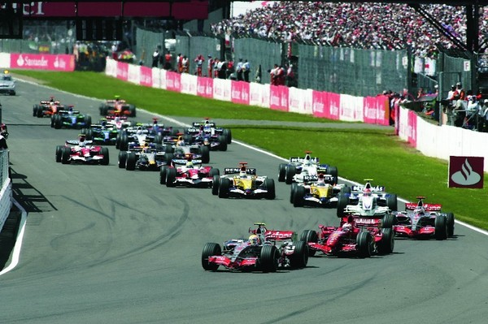
Sporting Events in Britain

Slide 2
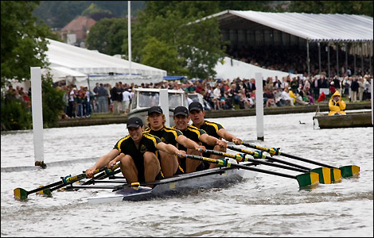
Henley Royal Regatta

Slide 3
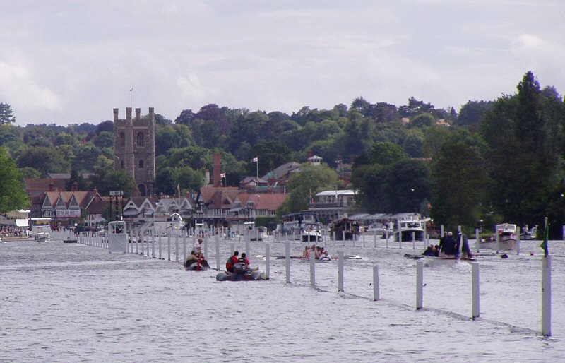
Henley Royal Regatta is a rowing event held every year on the River Thames by the town of Henley-on-Thames, England. The Royal Regatta is sometimes referred to as Henley Regatta, its original name pre-dating Royal patronage. It should not be confused with the three other regattas rowed over approximately the same course (Henley Women's Regatta, Henley Veterans Regatta and Henley Town and Visitors Regatta), each of which is an entirely separate event.
A race during the Henley Royal Regatta

Slide 4
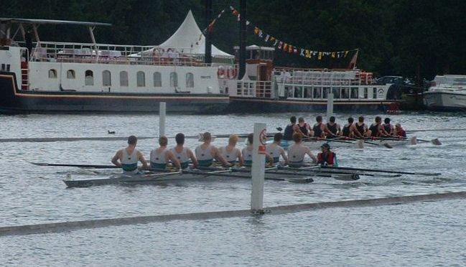
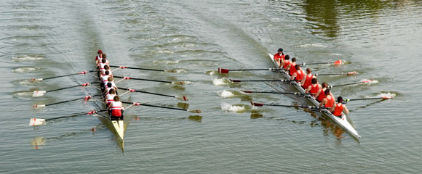
The regatta lasts for 5 days (Wednesday to Sunday) over the first weekend in July. The most prestigious event at the regatta is the Grand Challenge Cup for Men's Eights, which has been awarded since the regatta was first staged. As the regatta pre-dates any national or international rowing organisation, it has its own rules and organisation, although it is recognised by both British Rowing (the governing body of rowing in England and Wales) and FISA (the International Federation of Rowing Associations).The regatta is organised by a self-electing body of Stewards, who are largely former rowers themselves.
Two crews racing in the Temple Challenge Cup at Henley in 2003

Slide 5
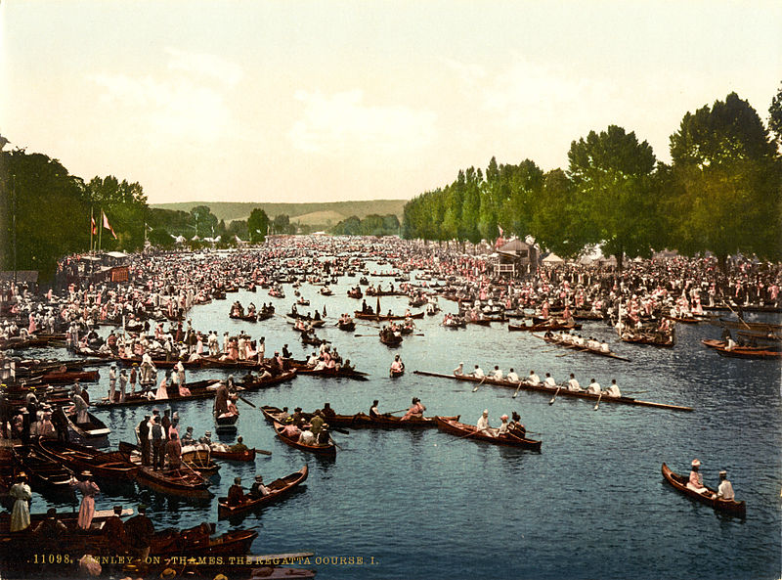
For most of its history, Henley Royal Regatta has only been open to male competitors but this has changed more recently. Women coxswains of male crews were permitted from 1975 and as such the first female competitor in the regatta was Christine Paul, cox of Furnivall Sculling Club in the Thames Challenge Cup in that year.
Regatta participants in the 1890s

Slide 6
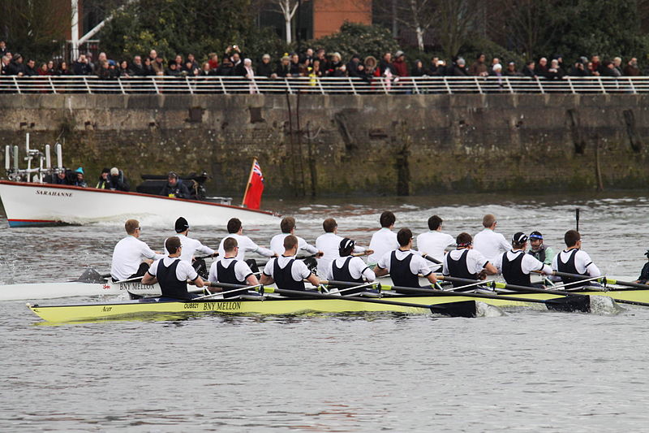
University Boat Race
In the nineteenth century, students at Oxford and Cambridge, Britain's two oldest universities, were huge fans of rowing. In 1829, the two schools agreed to hold a race against each other for the first time on the Thames River. The Oxford boat won and a tradition was born. Today, the University Boat Race is held every spring in either late March or early April.
Racing boats in 2013

Slide 7
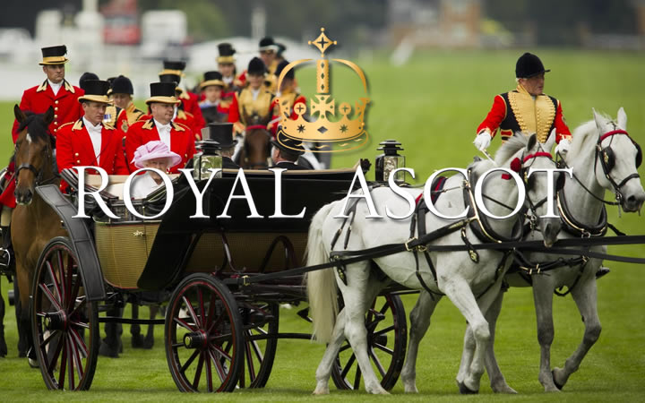

Slide 8
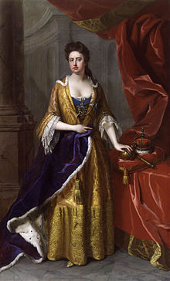
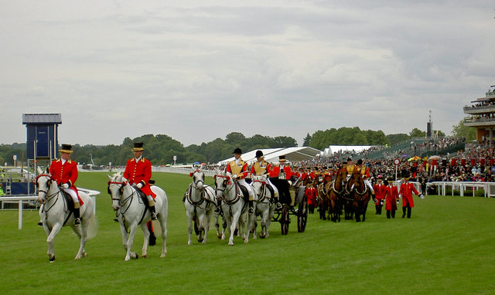
Ascot Racecourse was founded by Queen Anne in 1711 and since that time, a further eleven monarchs have leant their patronage to the Royal race course.
The Royal Meeting, held annually in the third week in June, is steeped in tradition and pageantry and is interwoven into the very fabric of British culture.
The five-day meeting commences on a Tuesday and each day begins with the Royal Procession - the arrival of The Queen and the Royal party in horse-drawn landaus, which parade along the track in front of the race- goers.
The Royal carriages leave after carrying The Queen to the races

Slide 9
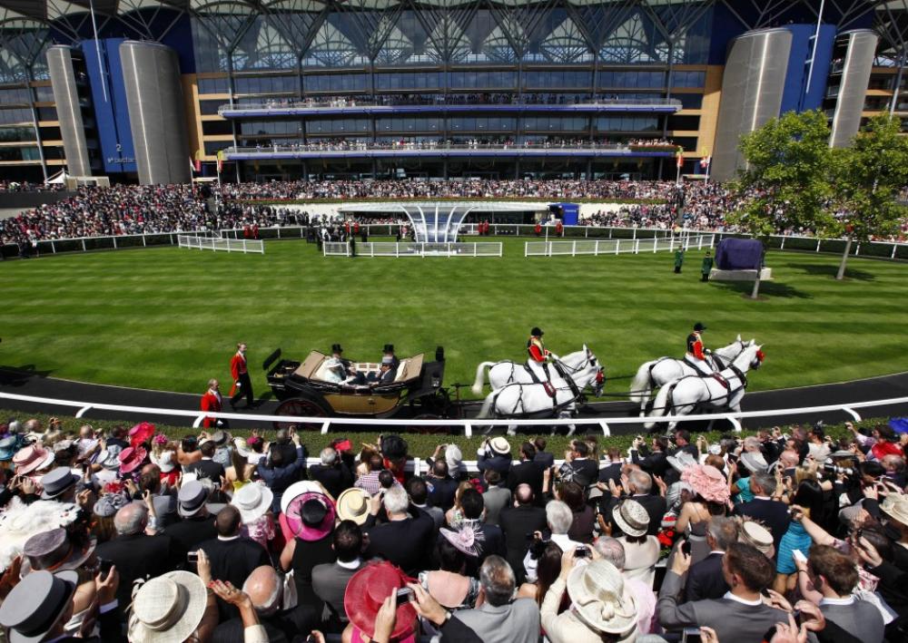
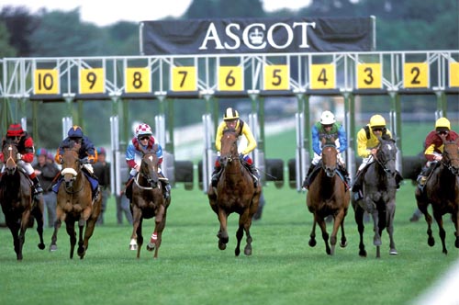
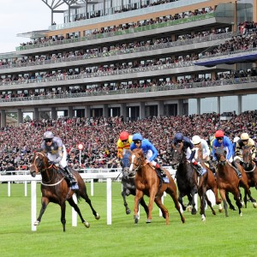
Over 300,000 people make the annual visit to Berkshire during Royal Ascot week, making this Europe’s best-attended race meeting. The Queen takes a close personal interest in the running of Ascot and is kept informed of the order of running and the development of the racing programme at the Royal Meeting.

Slide 11
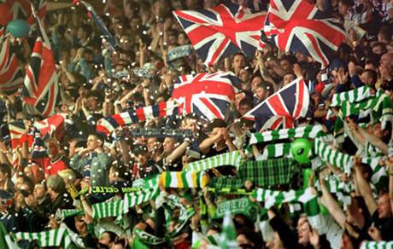
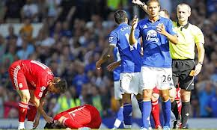
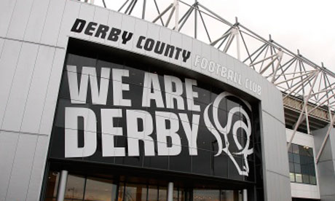
Famous Derby sporting institutions include Derby County Football Club, who were FA Cup winners in 1946, Football League champions in 1972 and again in 1975, and are currently members of the Football League Championship, having been relegated from the Premier League. They have played at Pride Park Stadium since 1997, having previously based at the Baseball Ground.

Slide 12
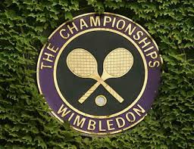
The Championships, Wimbledon

Slide 13
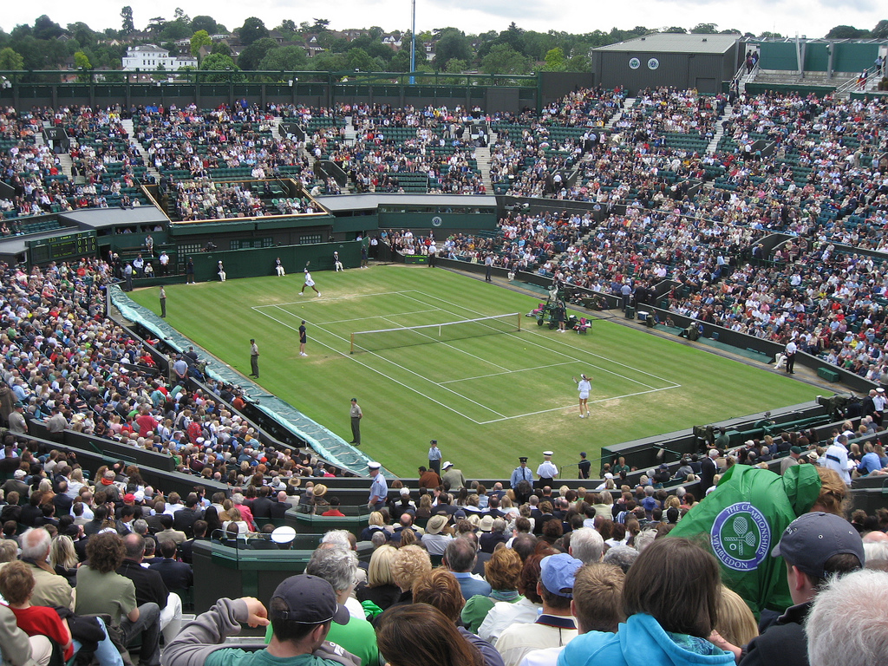
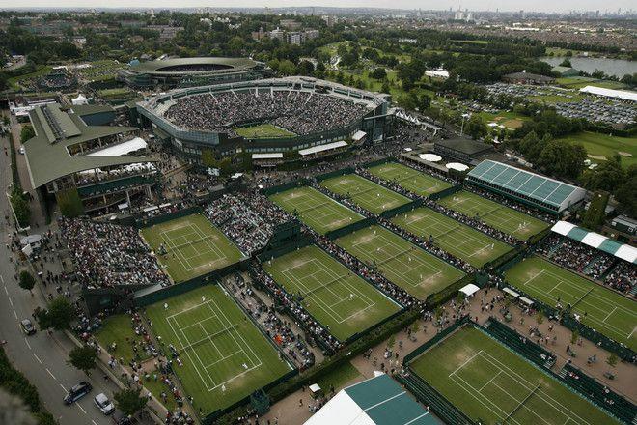
The Championships, Wimbledon, "The Wimbledon Championships" or simply Wimbledon is the oldest tennis tournament in the world, and widely considered the most prestigious. It has been held at the All England Club in Wimbledon, London since 1877. Wimbledon is the only Major still played on grass.

Slide 14
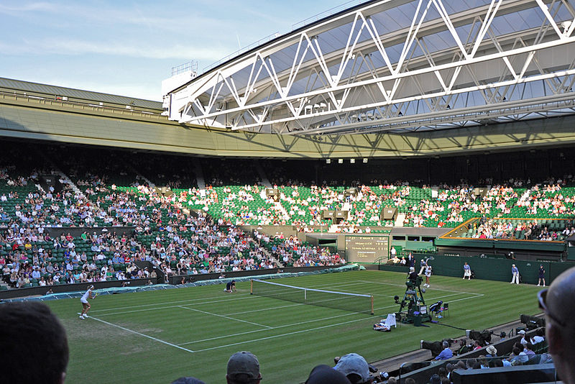
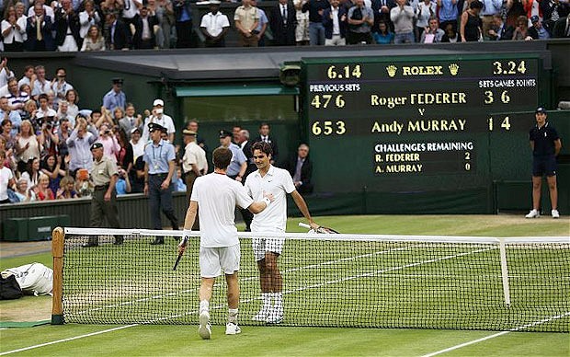
The tournament takes place over two weeks in late June and early July, culminating with the Ladies' and Gentlemen's Singles Final, scheduled for the second Saturday and Sunday respectively. Each year five major events are contested, as well as four junior events and three invitational events. Wimbledon traditions include a strict dress code for competitors, the eating of strawberries and cream by the spectators, and Royal patronage(покровительство). The tournament is also notable for the absence of sponsor advertising around the courts. In 2009, Wimbledon's Centre Court was fitted with a retractable roof to lessen the loss of playing time due to rain.
Centre Court with open roof at the 2010 Championships

Slide 15
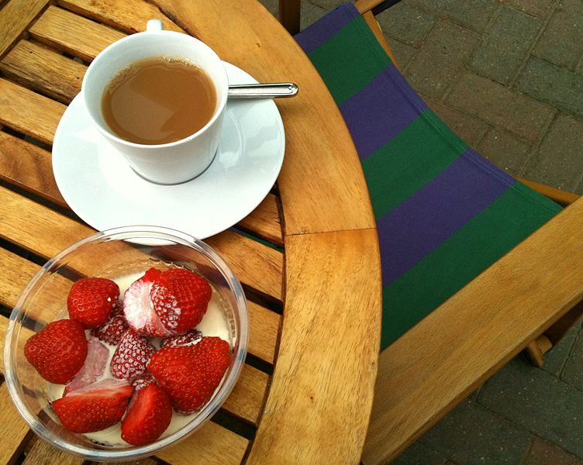
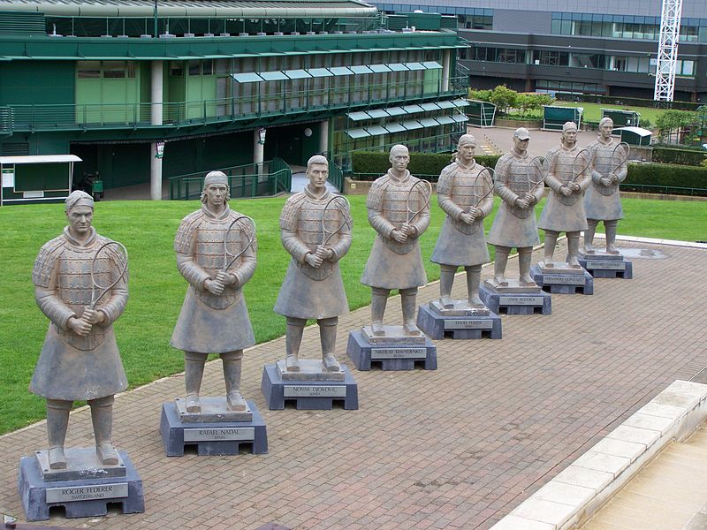
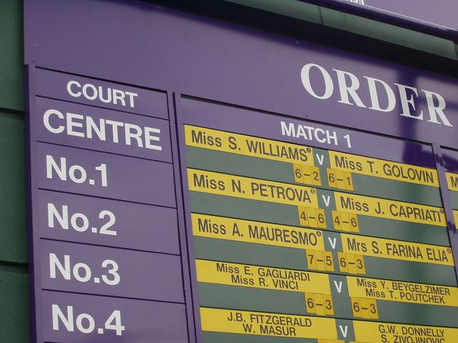
British strawberries and cream served at Wimbledon
Terracotta Warriors
The order of play for all courts is displayed on boards around the grounds

Slide 16
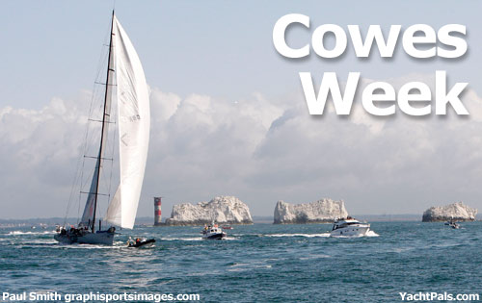

Slide 17
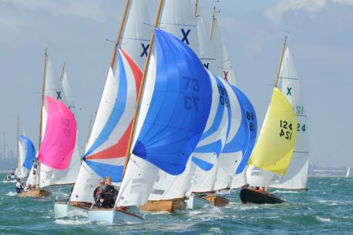
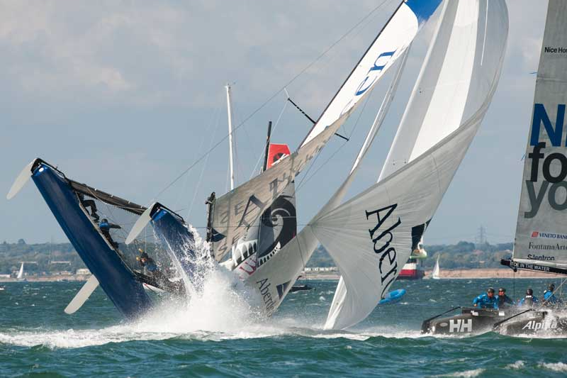
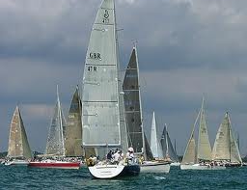
Cowes Week is one of the longest-running regular regattas in the world. With 40 daily races, up to 1,000 boats, and 8,500 competitors ranging from Olympic and world class professionals to weekend sailors, it is the largest sailing regatta of its kind in the world. Having started in 1826, the event is held on the Solent (the area of water between southern England and the Isle of Wight made tricky by strong double tides), and is run by Cowes Week Limited in the small town of Cowes on the Isle of Wight.

Slide 18
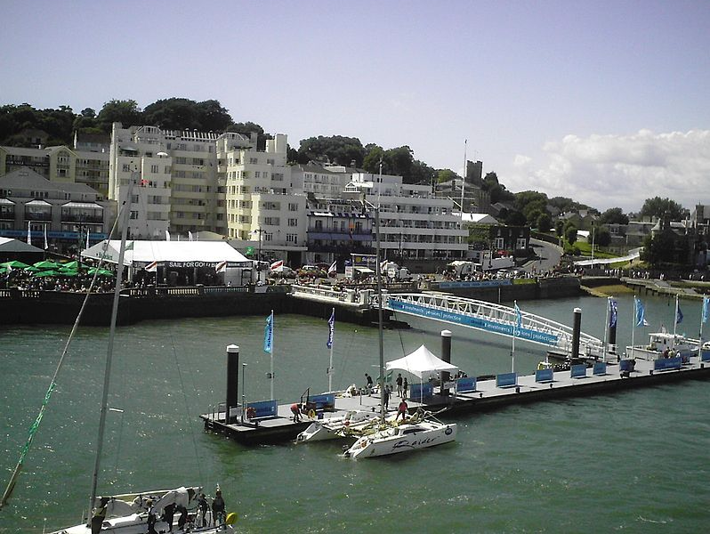
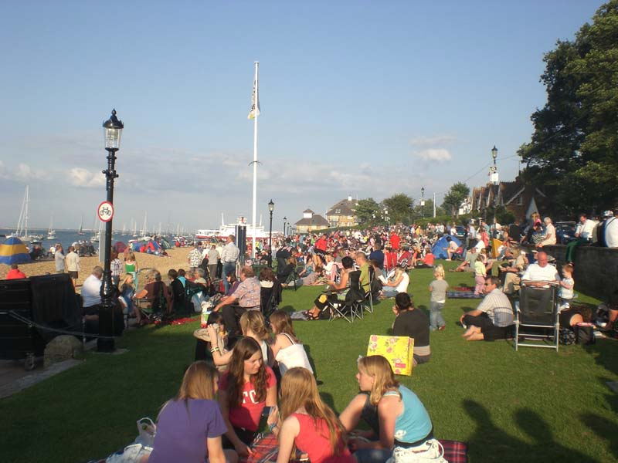
Cowes Week is held at the beginning of August, set after Glorious Goodwood in the social calendar, which in most years means, from the first Saturday after the last Tuesday in July, until the following Saturday. It is occasionally moved to another week if the state of the tides in the normal week is unfavourable or, as in 2012, to avoid a clash with the Olympic Games. The regatta is famous for its fireworks on the final Friday.
Cowes Parade in Cowes Week 2007

Slide 19
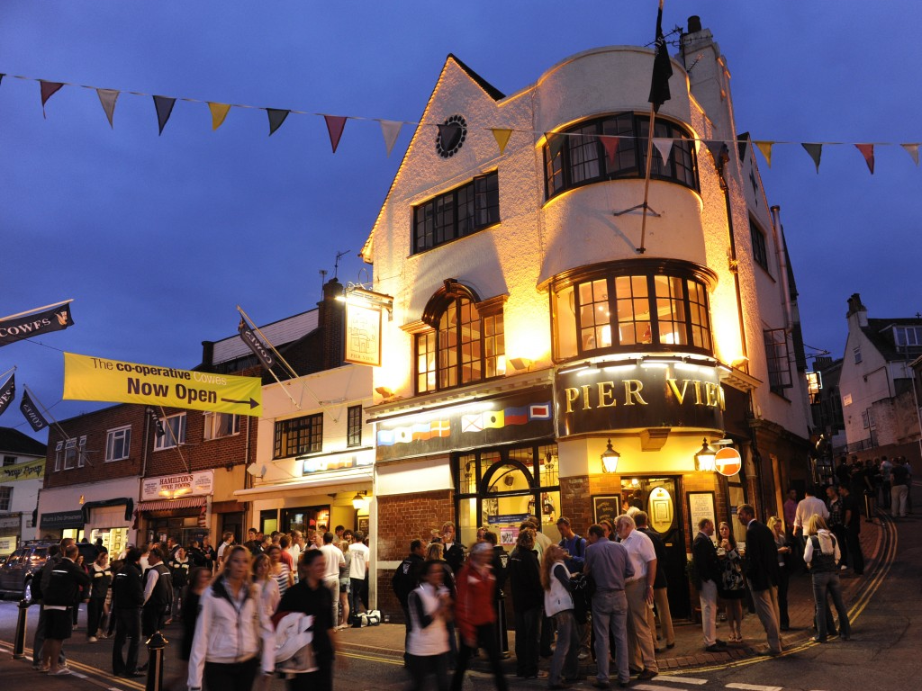
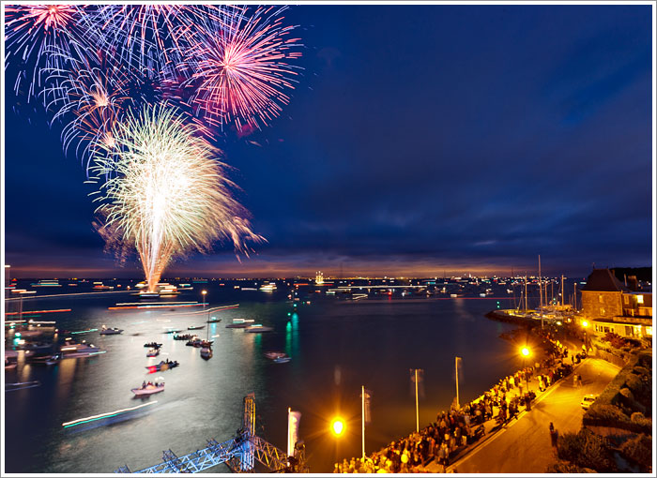
As well as the sailing activities, the week includes a large number of onshore events including live music and cocktail parties. Marquees are erected in the marinas serving food and drink, and the crowds overflow from busy public houses and restaurants around the narrow high street - the town becomes a hive of activity into the early hours of each morning. Around 100,000 visitors are attracted to Cowes by the festival atmosphere of the event each year in addition to all the competitors.

Slide 20
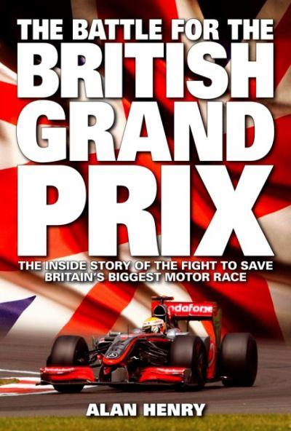
First held - 1926 In July
Most wins (drivers): Jim Clark
Alain Prost (5)

Slide 21
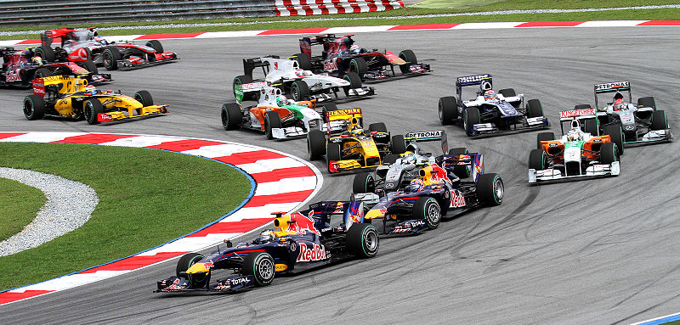
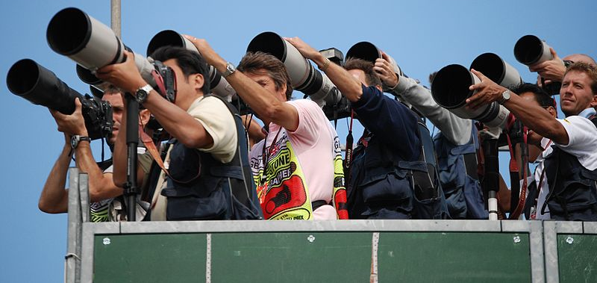
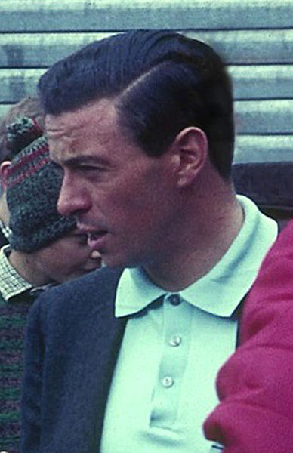
The British Grand Prix is a race in the calendar of the FIA Formula One World Championship. It is currently held at the Silverstone Circuit near the village of Silverstone in Northamptonshire. The British and Italian Grands Prix are the oldest continuously staged Formula One World Championship Grands Prix. Twelve British drivers have won the British Grand Prix, with Englishman Stirling Moss being the first and Scotsman Jim Clark winning 5 times.
Formula One in 2010
Track photographers at the 2007 British Grand Prix.

