Slide 1
PUBLIC
HOLIDAYS
AND
CELEBRATIONS

Slide 2
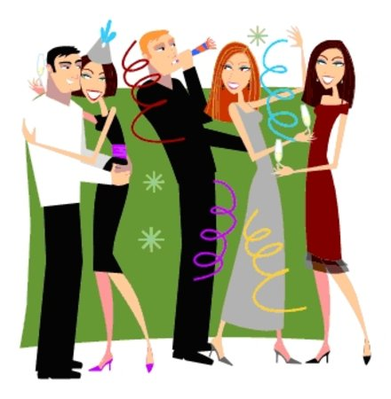
NEW YEAR’S DAY
It is commonly
believed that
New Year's Day
is less important
in England than
Christmas. It is
true in the
southern and
eastern parts of the country. However, even there, the welcoming of the New Year is growing in popularity, particularly among younger people who prefer to spend Christmas with kin, but New Year with friends. New Year's parties go all night through.

Slide 3
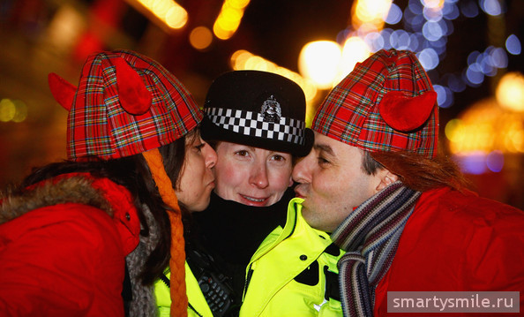
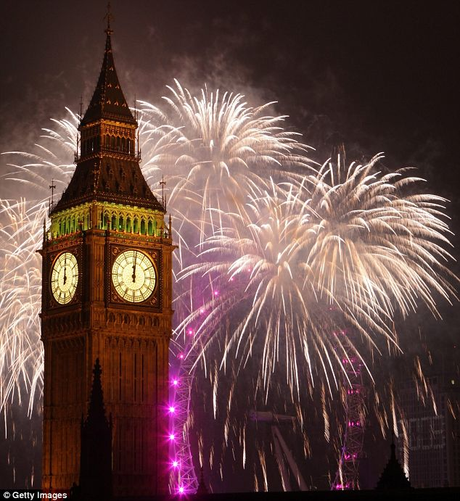
The most famous places of festivities are Piccadilly Circus and Trafalgar Square in London where crowds of people greet the New Year with the linked-arm singing of "Old Lang Syne", kissing total strangers, blowing whistles and automobile horns and shooting firecrackers. Someone usually falls into the fountain in Trafalgar Square. Unfortunately for all these midnight celebrators, January 1st is not a public holiday in England.

Slide 4
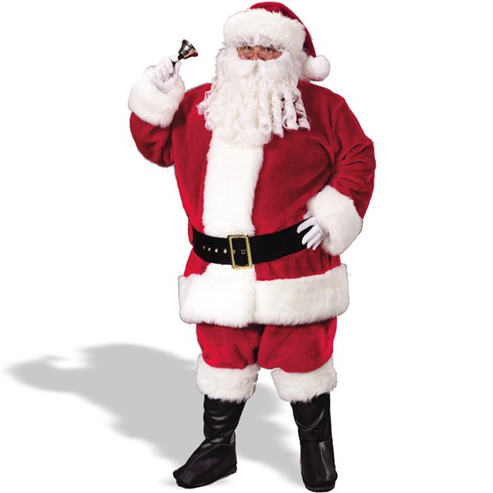
In Scotland, New Years celebration is the greatest festival of the year, where it even has a special name, Hogmanay. Nobody, however, can successfully explain where this word comes from. After midnight people visit their friends. They carry cakes and spiced ale to wish their hosts a good year.
In Wales, the back door releases the Old Year at the first stroke of midnight: it is then locked "to keep the luck in", and at the last stroke the New-Year is let in at the front.

Slide 5
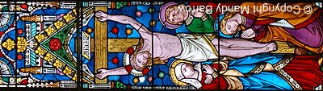
GOOD FRIDAY
Good Friday is the Friday before Easter Sunday
(Easter Day).
On Good Friday, Christians remember the day when Jesus
was crucified on a cross.
The date of Good Friday changes every year.
The date of the first Good Friday will never be known.

Slide 6
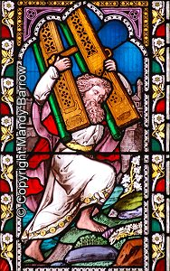
WHAT HAPPENED ON GOOD FRIDAY?
Jesus was arrested and was tried, in a mock trial. He was handed over to the Roman soldiers to be beaten and flogged with whips. A crown of long, sharp thorns was thrust upon his head.
Jesus was forced to carry his own cross outside the city to Skull Hill. He was so weak after the beating that a man named Simon, who was from Cyrene, was pulled from the crowd and forced to carry Jesus' cross the rest of the way.
Jesus was nailed to the cross. Two other criminals were crucified with him, their crosses were on either side of him. A sign above Jesus read "The King of the Jews."

Slide 7
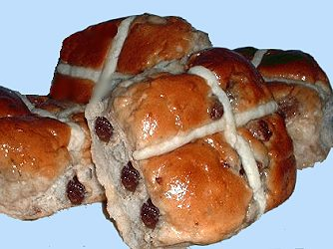
Traditional Food
It is traditional to eat warm 'hot cross buns' on Good Friday. Hot Cross Buns with their combination of spicy, sweet and fruity flavours have long been an Easter tradition.
Why do we eat Hot Cross Buns?
The pastry cross on top of the buns symbolises and reminds Christians of the cross that Jesus was killed on.
Hot Cross Buns
The buns were traditionally eaten
at breakfast time, hot from the
oven. They were once sold by
street vendors who sang a little
song about them.

Slide 8

EASTER MONDAY
For Christians Easter Sunday is the high point of the year. They celebrate the Resurrection of Jesus Christ.
As in many other European and New World countries, eggs and rabbits (signs of fertility and new life) are traditional symbols of Easter in the British Isles. Chocolate bunnies and Easter eggs, often adorned in colorful foil wrappers, are given to children as presents or are hidden for the Easter morning "egg hunt."

Slide 9

The tradition of decorating real eggs for
Easter dates back to the
Middle Ages. In 1290 the
English king, Edward I, ordered 450 eggs to be covered in gold leaf to be given as Easter presents. It is thought that the bright hues used to decorate Easter eggs were meant to mirror the colors of the reawakening spring growth.

Slide 10
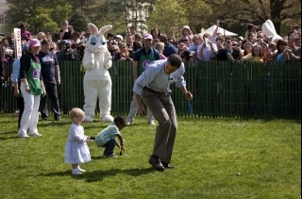
Another British Easter custom is egg rolling or the egg race, when competitors try to be the first to roll their egg across a course or down a hill… without breaking it!

Slide 11
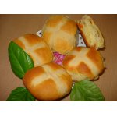

These sweet treats are marked
with a cross. Aside from eggs,
the best-known English Easter
food is probably the hot cross bun.
Easter Sunday in the British Isles is traditionally marked by church services, often held at dawn so that worshippers can view the sunrise, a symbol of Christ's resurrection. Afterwards Easter eggs are exchanged and eaten.

Slide 12
MAY DAY HOLIDAY
The old Celtic celebration of May Day was called Beltane, (or Beltaine in its most popular Anglicized form) the Celtic god of light or the sun (Bel, Beli or Belinus). He, in turn, may be traced to the Middle Eastern god Baal. Other names for May Day include: Cetsamhain ('opposite Samhain') and Walpurgisnacht (in Germany). For the Celts, Beltane was a festival where fires were set to mark the beginning of summer: "They rolled wheels of fire down hillsides, lit bonfires, and drove their cattle through the flames in a ceremony of purification".

Slide 13
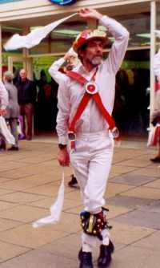
These festivals reached their height in England during the Middle Ages. On the first day of May, English villagers awoke at daybreak to roam the countryside gathering blossoming flowers and branches. A towering maypole was set up on the village green. This pole, usually made of the trunk of a tall birch tree, was decorated with bright field flowers. The villagers then danced and sang around the maypole, accompanied by a piper. Usually the Morris dance was performed by dancers wearing bells on their colorful costumes. Often the fairest maiden of the village was chosen queen of the May. Sometimes a May king was also chosen. These two led the village dancers and ruled over the festivities. In Elizabethan times, the king and queen were called Robin Hood and Maid Marian.

Slide 14
VIDEO

Slide 15
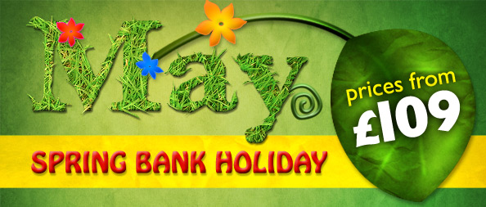
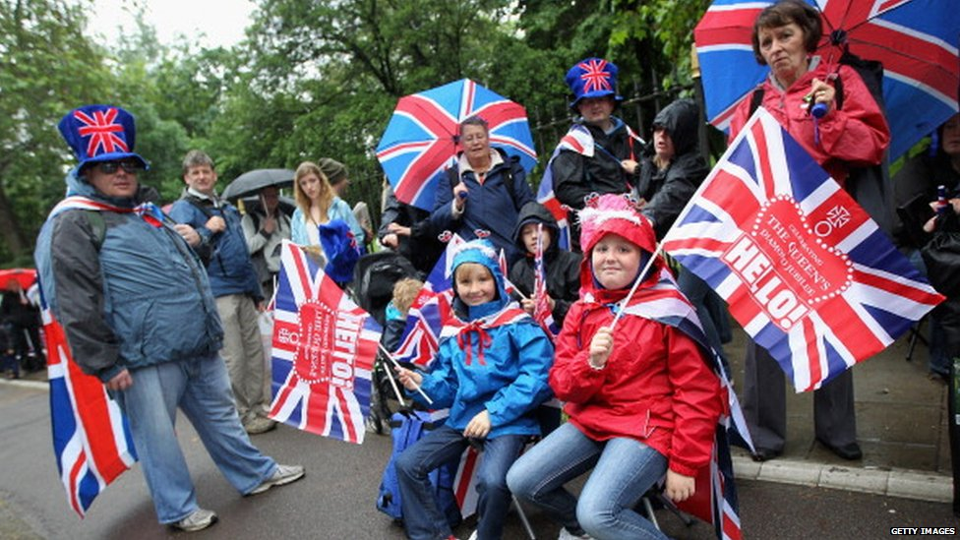
SPRING DAY HOLIDAY
The spring bank holiday, also known as the late May bank holiday, is a time for people in the United Kingdom to have a day off work or school. It falls on the last Monday of May but it used to be on the Monday after Pentecost.

Slide 16
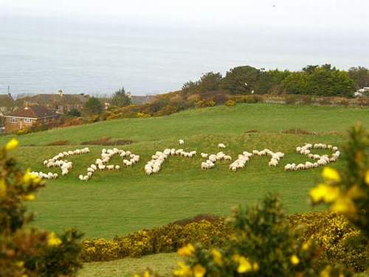
WHAT DO POPLE DO?
For many people the spring bank holiday is a pleasant day off work or school. Some people choose to take a short trip or vacation. Others use the time to walk in the country, catch up with family and friends, visit garden centers or do home maintenance. However, in some parts of the United Kingdom, there are some customs associated with this day.

Slide 17
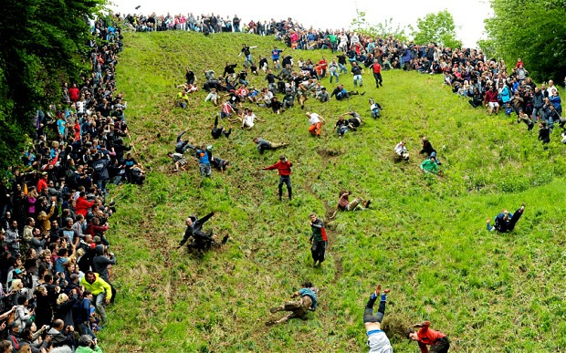
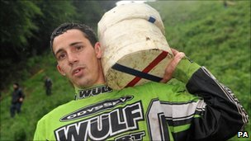
On Cooper's Hill in Brockworth, Gloucestershire, people race down a steep hill following a large round cheese. The hill is concave and has an incline of 1:1 in some places. The first person to cross the finishing line wins a Double Gloucester cheese weighing about 8lbs (around 3.5kg). The custom may have been started by the Romans or ancient Britons and be an ancient fertility rite or a way of guaranteeing the rights of the villagers to graze their livestock on the surrounding land. In some years, there have been a lot of injuries, causing the event to be cancelled a couple of times in recent years. In these years, the cheese was rolled down the hill, but nobody was allowed to chase it.

Slide 18
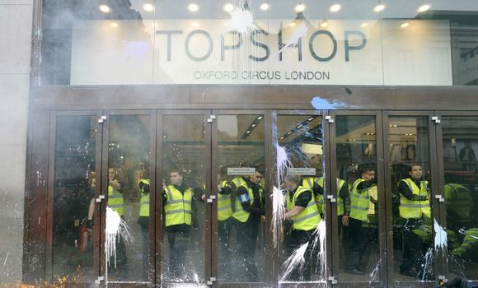

PUBLIC LIFE
The last Monday in May is a bank holiday. Many organizations, businesses and schools are closed. Stores may be open or closed, according to local custom. Public transport systems often run to a holiday timetable.

Slide 19

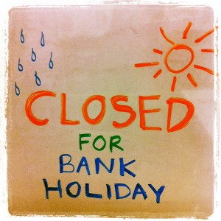
SUMMER BANK HOLIDAY
In England, Wales and Northern Ireland, the summer bank holiday is on the last Monday of August. In Scotland it is on the first Monday of August. This day marks the end of the summer holidays for many people who return to work or school in the autumn.

Slide 20
WHAT DO POPLE DO?
For many people, the summer bank holiday marks the end of the summer. Some people take trips or short vacations during the three day weekend. For others, it is another opportunity to work in their gardens or carry out home improvements.
In London the Notting Hill Carnival is held. This street festival is best known for its exuberant costumes, dancing and music played by steel drum bands. The festival has been held every year since 1965 and was originally organized by immigrants from the Caribbean, particularly Trinidad, to the United Kingdom. It started as a protest against the racism, poor working and housing conditions that they suffered.
Today, the Notting Hill Carnival is a multicultural celebration, attracting over two million people. It is thought to be the second largest street carnival in the world. In the past, a considerable amount of public disorder occurred round the event, but it has been calmer in recent years.

Slide 21
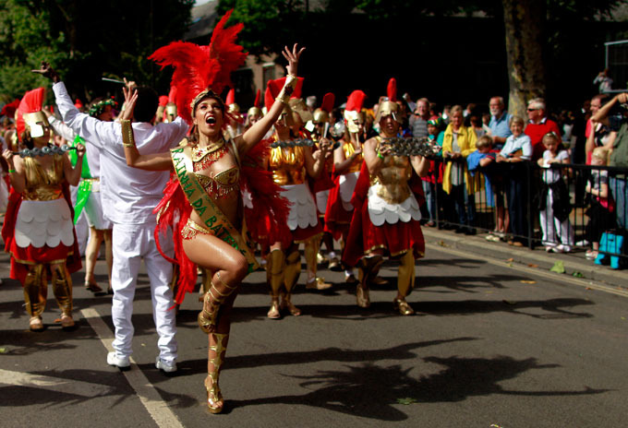
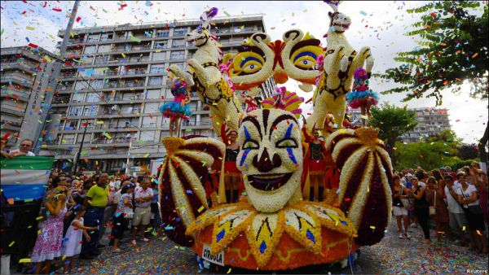
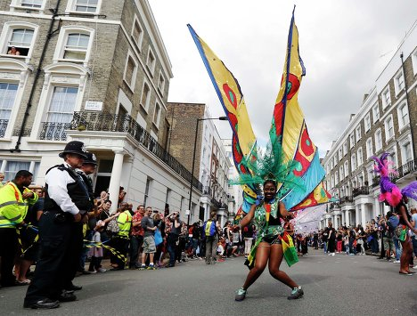
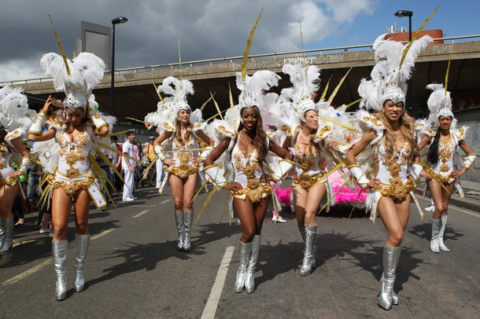

Slide 22
PUBLIC LIFE
On the summer bank holiday, many organizations, businesses and schools are closed. Stores may be open or closed, according to local custom. There is more local variation in Scotland, where local conditions, rather than national laws, dictate whether organizations and businesses close for the day. Public transport systems often run to a holiday timetable. As this three-day weekend marks the end of the summer holiday period, there can be a lot of congestion on roads and public transport systems.

Slide 23
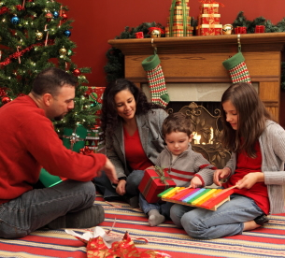
CHRISTMAS DAY
Christmas Day is celebrated in the United Kingdom on December 25. It traditionally celebrates Jesus Christ's birth but many aspects of this holiday have pagan origins. Christmas is a time for many people to give and receive gifts and prepare special festive meals.

Slide 24
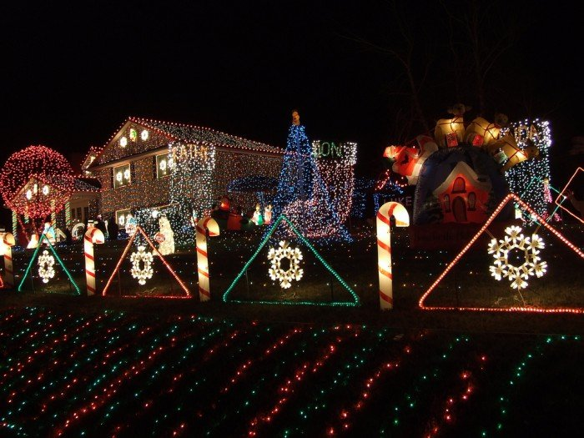
WHAT DO POPLE DO?
Prior to Christmas Day, people decorate their homes and gardens prior to Christmas Day. These decorations may include: Christmas trees. Small colored fairy lights.
Leaves and berries from holly trees and mistletoe bushes.
Various other decorations with rich colors that spark the Christmas mood. In many towns and cities, the shopping streets are also decorated with lights and large pine trees, often specially imported from Norway. In some places a Nativity scene is arranged. This illustrates the story of Jesus' birth using statues or actors and live animals. Many churches hold special services in the night before Christmas Day.

Slide 25
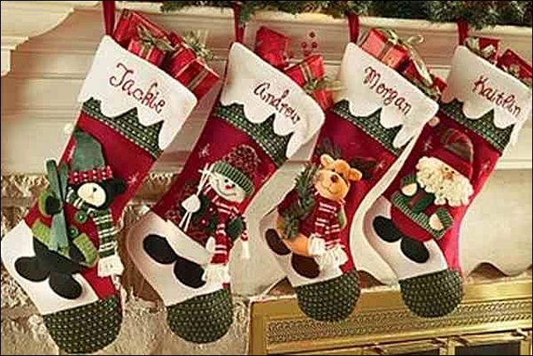
Many people spend Christmas Day with family members, with whom they exchange gifts and cards. Many children wake up to find a sock or stocking filled with small gifts on their bed or somewhere else in the house. These have supposedly been brought by a mythical figure called 'Father Christmas' or 'Santa Claus', who lives for most of the year at the North Pole. He travels in a sleigh pulled by reindeer and enters houses by climbing down the chimney. He hopes to enjoy a small snack of mince pies and brandy at each house. He supposedly travels so fast that he can deliver presents to all children in one night, although some in some stories elves help him with his work.

Slide 26
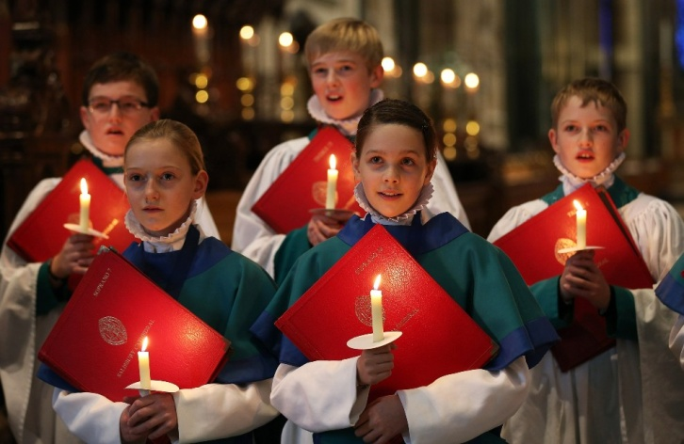
Later in the day, people may attend special church services, even if they do not usually go to church. Nearly everyone prepares and eats a special meal. This often includes roast turkey, potatoes and parsnips, and other vegetables. After the main course, Christmas pudding is often eaten. This is a heavy steamed, dense, cake-like pudding filled with dried fruit and nuts. Burning brandy is often poured over it as it is served, giving a spectacular effect. Mince pies are also popular on Christmas Day. They are sweet pastry cases filled with a mixture of dried fruit, fat and alcohol.

Slide 27
Symbols of Christmas
There are many Christmas symbols. These include leaves and berries from the holly tree and mistletoe bush, pine trees, candles and small lights. Figures associated with the season are Father Christmas or Santa Claus, the baby Jesus, Mary, Joseph and the other characters from the Nativity story. Presents and Christmas food, such as turkey, Christmas pudding and mince pies also symbolize Christmas. A special mention should be reserved for the robin red breast. This small bird, with its red feathered breast, is at its most beautiful in the middle of the winter and is often seen as a decoration on Christmas cards, wrapping paper and cakes.

Slide 28
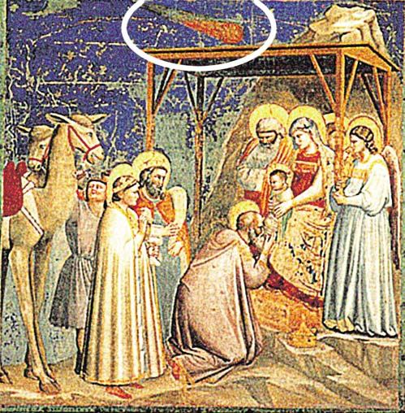
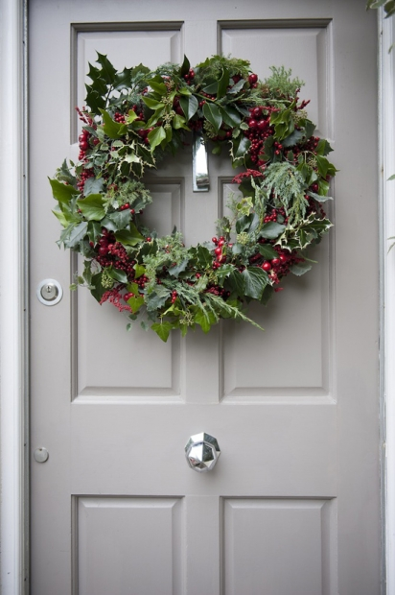
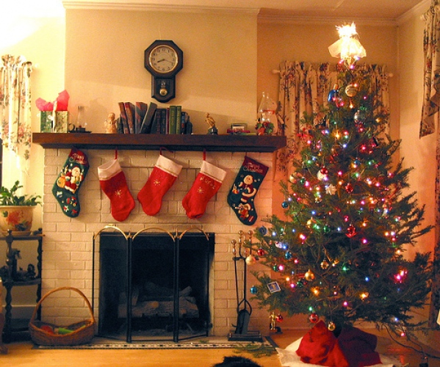
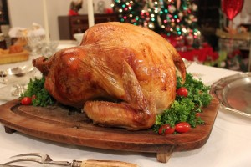

Slide 29
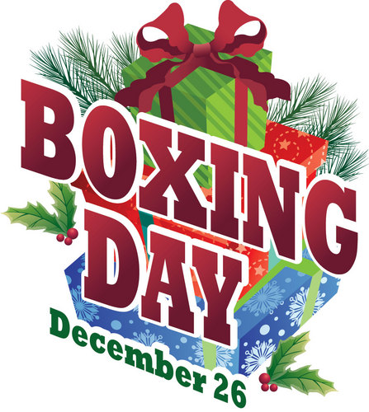
BOXING DAY
Boxing Day in the United Kingdom is the day after Christmas Day and falls on December 26. Traditionally, it was a day when employers distributed money, food, cloth (material) or other valuable goods to their employees. In modern times, it is an important day for sporting events and the start of the post-Christmas sales.

Slide 30
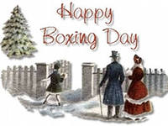
WHAT DO POPLE DO?
For many people Boxing Day is a time to recover from the excesses of Christmas day and an opportunity to spent time with family, friends and neighbors. Some people choose to go for a walk in the countryside, while other flock to the post-Christmas sales in large stores that often begin on Boxing Day. Some people even spend part of the night and early morning queuing to get into the stores when the best bargains are still available

Slide 31
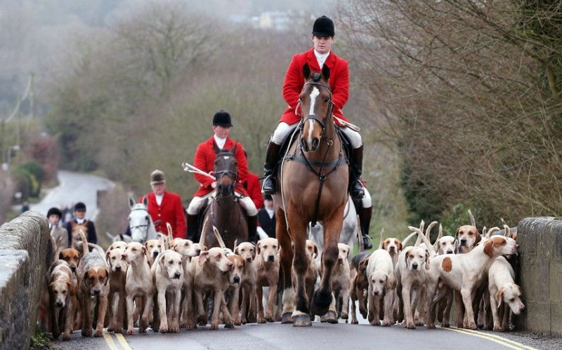
Boxing Day is also an important day for sports events. Traditionally, using dogs to hunt for foxes was a popular sport amongst the upper classes. Pictures of hunters on horseback dressed in red coats and surrounded by hunting dogs are often seen as symbolic of Boxing Day. Nowadays, fox hunting is outlawed. Horse racing and football (soccer) are now popular sports.

Slide 32
BACKGROUNDS AND SYMBOLS
There are a number of stories behind the origin of the term 'Boxing Day'. It used to be customary for employers to give their employees or servants a gift of money or food in a small box on this day. This is still customary for people who deliver letters or newspapers, although the gift may be given before Christmas Day. In feudal times, the lord of the manor would gather all those who worked on his land together on this day and distribute boxes of practical goods, such as agricultural tools, food and cloth. This was payment for the work that they had done throughout the passed year.
Other stories relate to servants being allowed to take a portion of the food left over from the Christmas celebrations in a box to their families and the distribution of alms from the Church collection box to poor parishioners. These traditions have evolved into the Christmas hampers that many large employers distribute, although these are now often distributed in the week before Christmas.

Slide 33
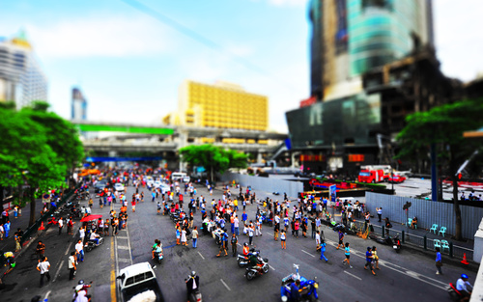
NATIONAL DAYS
National Days are not celebrated in Britain in the same way as they are in a number of other countries. Only St Patrick's Day in Northern Ireland (and the republic of Ireland) and St Andrew's Day in Scotland (from 2007) are taken as an official holiday. All the other national days are normal working days.

Slide 34
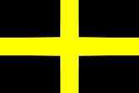

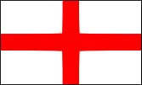
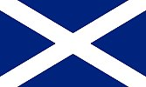
WALES
1 March - The national day of Wales is St David's Day.
St David is Wales's patron saint.
NORTHEN IRELAND
17 March - The national day of Northern Ireland is St Patrick's Day
St Patrick is Ireland's patron Saint
23 April - The national day of England is St George's Day.
St George is England's patron saint.
ENGLAND
30 November - The national day of Scotland’s is St Andrew's Day
St Andrew is the patron saint of Scotland.
SCOTLAND

Slide 35

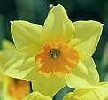
St David (Dewi Sant was a Celtic monk, abbot and bishop, who lived in the sixth century. He spread the word of Christianity across Wales.
The most famous story about Saint David tells how he was preaching to a huge crowd and the ground is said to have risen up, so that he was standing on a hill and everyone had a better chance of hearing him.
The national emblems of Wales are daffodils and leeks.
St David's Day is commemorated by the wearing of daffodils or leeks. Both plants are traditionally regarded as national emblems.
The Leek
There are many explanations of how the leek came to be adopted as the national emblem of Wales. One is that St David advised the Welsh, on the eve of battle with the Saxons, to wear leeks in their caps to distinguish friend from the enemy. Shakespeare mentions in Henry V, that the Welsh archers wore leeks at the battle of Agincourt in 1415.

Slide 36
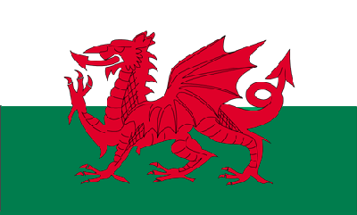
On St David's Day, some children in Wales dress in their national costume, which consists of a tall black hat, white frilled cap and long dress. The national flag of Wales, depicting a fiery red dragon (Y Ddraig Goch) against a green and white background, is also flown. the Naional Flag of Wales?
the Naional Flag of Wales

Slide 37
St. Patrick's Day is celebrated on 17 March.
St. Patrick's Day is celebrated in the whole of Ireland on 17 March, in honour of St Patrick, the patron saint of Ireland.
Who was St. Patrick?
Saint Patrick, the patron saint of Ireland, is credited with bringing Christianity to Ireland. He was born in Wales somewhere around AD 385. He was carried off by pirates and spent six years in slavery before escaping and training as a missionary.
The most famous story about Saint Patrick is him driving the snakes from Ireland. He died on 17th March in AD 461 and this day has since been commemorated as St. Patrick’s Day.

Slide 38
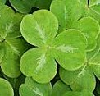
The national emblem of Ireland is the Shamrock. Patrick used the three-leaved shamrock to explain how the Trinity of the Father, Son and Holy Spirit could exist as separate parts of the same being. His followers took to wearing a shamrock in celebration.
St Patrick's day is marked by the wearing of shamrocks (a clover-like plant), the national emblem of both Northern Ireland and the Republic of Ireland.
St.Patrick’s Day is celebrated with parades in the large cities, the wearing of the green and drinking Guinness (traditional drink of Ireland).

Slide 39
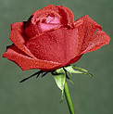
St George's Day is on 23 April.
St George's Day is celebrated in England on 23 April, in honour of St George, the patron saint of England.

Slide 40
Who was St St George?
A story dating back to the 6th century tells that St George rescued a maiden by slaying a fearsome fire-breathing dragon. The Saint's name was shouted as a battle cry by English knights who fought beneath the red-cross banner of St George during the Hundred Years War (1338-1453).
What is the national emblems of England?
The national emblem and national flower of England is a red rose
The flower has been adopted as England’s emblem since the time of the Wars of the Roses - civil wars (1455-1485) between the royal house of Lancaster (whose emblem was a red rose) and the royal house of York (whose emblem was a white rose).
What is England's National Dress?
England does not have a national dress.

Slide 41
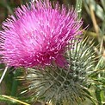
Who was St Andrew?
St. Andrew was one of Christ's twelve apostles. Some of his bones are said to have been brought to what is now St. Andrews in Fife during the 4th century. Since medieval times the X-shaped saltire cross upon which St. Andrew was supposedly crucified has been the Scottish national symbol.
What is the national emblems of Scotland?
The national emblem and national flower of Scotland is the thistle, a prickly-leaved purple flower which was first used in the 15th century as a symbol of defence.
The Scottish Bluebell is also seen as the flower of Scotland.
What is the National Dress of /Scotland?
The national dress of Scotland is a kilt with shirt,
waistcoat and tweed jacket, stockings with
garter flashes, brogue shoes and a sporran.

Slide 42
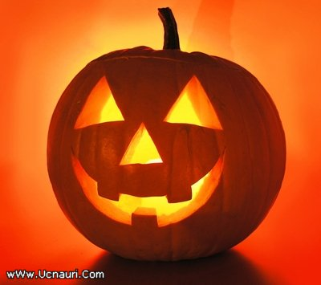
HALLOWEEN
Halloween is a holiday annually celebrated on October 31. Some people hold Halloween parties on or around this date, where the hosts and guests often dress up as skeletons, ghosts or other scary figures. Common symbols of Halloween include pumpkins, bats and spiders.

Slide 43
What do people do?
Halloween celebrations in the United Kingdom include parties where guests are often expected to arrive in a costume to reflect the day's theme. Other people gather together to watch horror films, either at home or at a cinema.
Some children go trick-or-treating. This means that they dress up and go to other peoples' houses, knocking on the door for treat of sweets or a snack. Those who do not give out a treat may be tricked with a joke instead.
Halloween has its origins in pagan festivals in England, Scotland, Wales and Ireland. Many stores and businesses see Halloween as a chance to promote products with a Halloween theme.

Slide 44
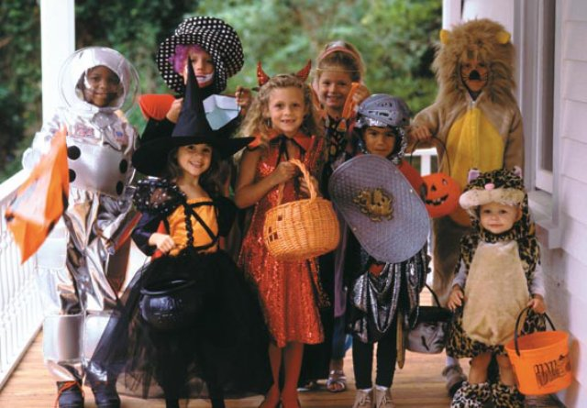
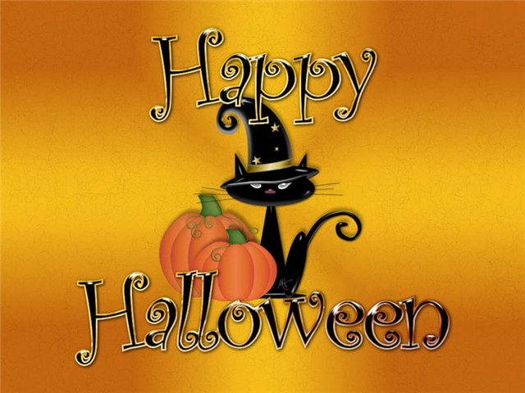

Slide 45
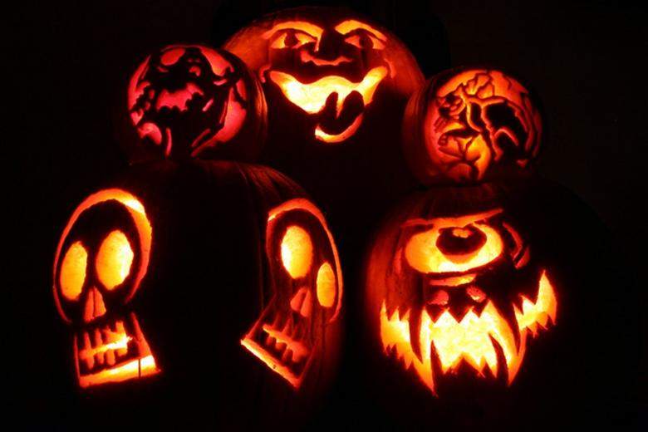
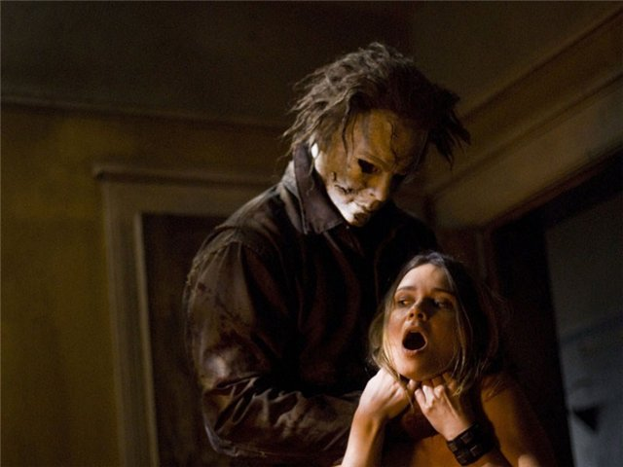
Symbols
There are various symbols are associated with Halloween. The colors orange and black are very common. Other symbols include pumpkin lanterns, witches, wizards, ghosts, spirits and characters from horror films. Animals associated with the festival include bats, spiders and black cats.

Slide 46
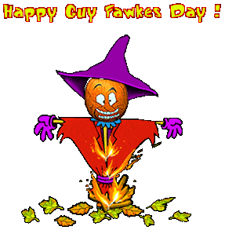
Guy Fawkes Night
It is annually held on November 5. It is sometimes known as Bonfire Night and marks the anniversary of the discovery of a plot organized by Catholic conspirators to blow up the Houses of Parliament in London in 1605. Many people light bonfires and set off fireworks

Slide 47
What do people do?
Many people light bonfires and set off fireworks. As it is the end of autumn, it is the ideal opportunity to burn garden rubbish. Some light small bonfires in their own gardens, while other light larger ones in a communal space. In some towns and cities, the municipality organizes a bonfire and professional firework display in a park. These tend to be very popular. Due to its proximity to Halloween, many people organize a combined party for Guy Fawkes Night and Halloween. These parties often include elements from both festivals, such as a bonfire and dressing up in spooky outfits. Popular foods include toffee apples, bonfire toffee and potatoes baked in the ashes of the fire. Guy Fawkes, a Catholic, was arrested, tortured and executed for his part in the plot to blow up the Houses of Parliament. Hence many Catholics are more restrained in their celebration of this day. In addition, many injuries and even deaths occur as a result of fireworks being used incorrectly. For this reason, many safety campaigners call for the sale of fireworks to the public to be restricted even more than at present and for more professional displays to be organized.

Slide 48
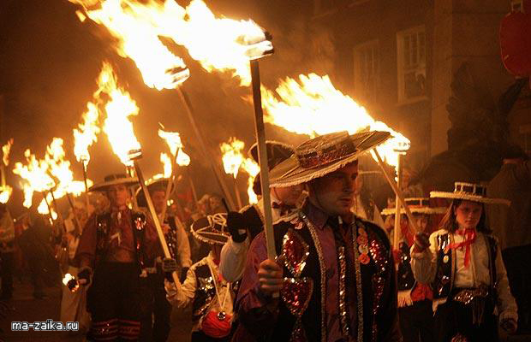

Slide 49
BRITISH TRADITIONS AND CUSTOMS
British nation is considered to be the most conservative in Europe. It is not a secret that every nation and every country has its own customs and traditions. In Great Britain people attach greater importance to traditions and customs than in other European countries. Englishmen are proud of their traditions and carefully keep them up. The best examples are their queen, money system, their weights and measures.

Slide 50
